Slide 1

DevOps and
Continuous Delivery Reference Architectures
Derek E. Weeks
VP and DevOps Advocate
Sonatype
2016

Slide 2









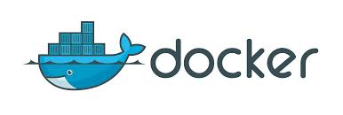





Common Elements of the Software Supply Chain
Notes:
Continuous Delivery and DevOps Reference Architectures include many common tool choices. The most common tool choices we find in these reference architectures are: Eclipse, git, Cloudbees Jenkins / Atlassian Bamboo, Sonatype Nexus, Atlassian JIRA, SonarQube, Puppet, Chef, Rundeck, Maven / Ant / Gradle, Subversion (svn), Junit, LiveRebel, ServiceNow

Slide 3
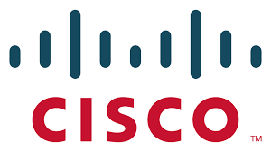
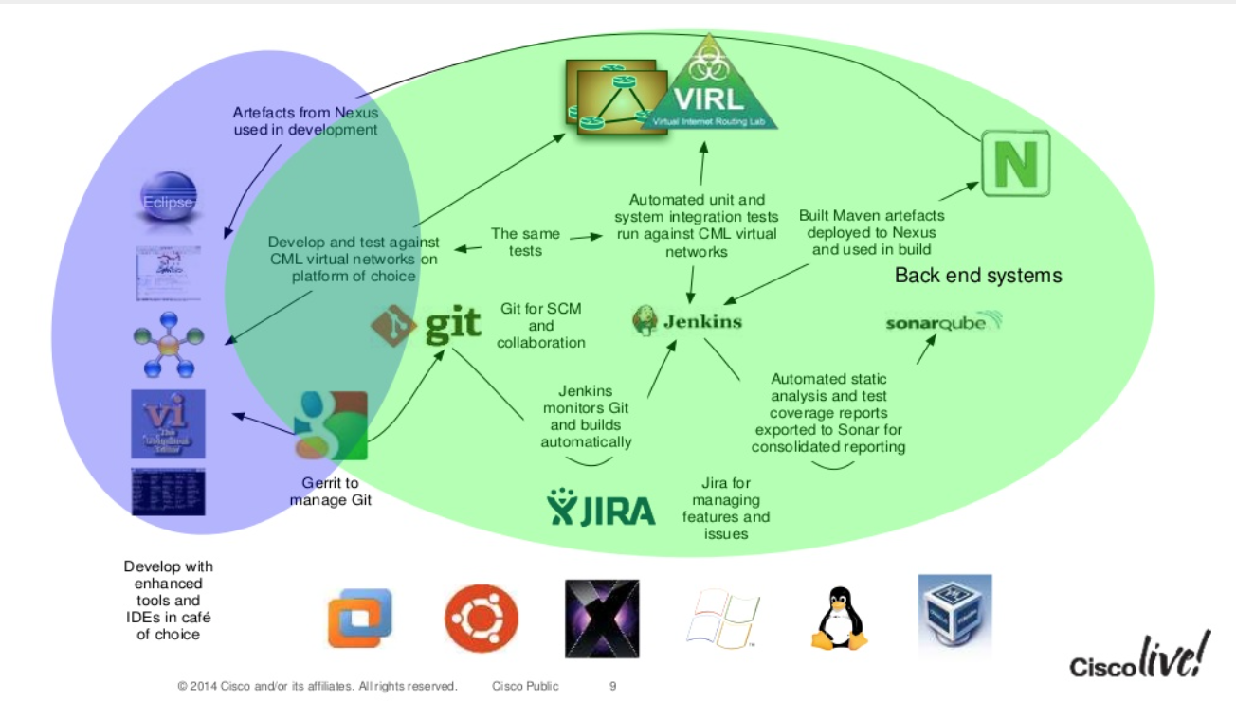
According to Cisco
Link to Presentation: Enabling DevOps
http://bit.ly/25i0RQF
Notes:
Continuous Delivery and DevOps Reference Architectures include many common tool choices. The most common tool choices we find in these reference architectures are: Eclipse, git, Cloudbees Jenkins / Atlassian Bamboo, Sonatype Nexus, Atlassian JIRA, SonarQube, Puppet, Chef, Rundeck, Maven / Ant / Gradle, Subversion (svn), Junit, LiveRebel, ServiceNow

Slide 4

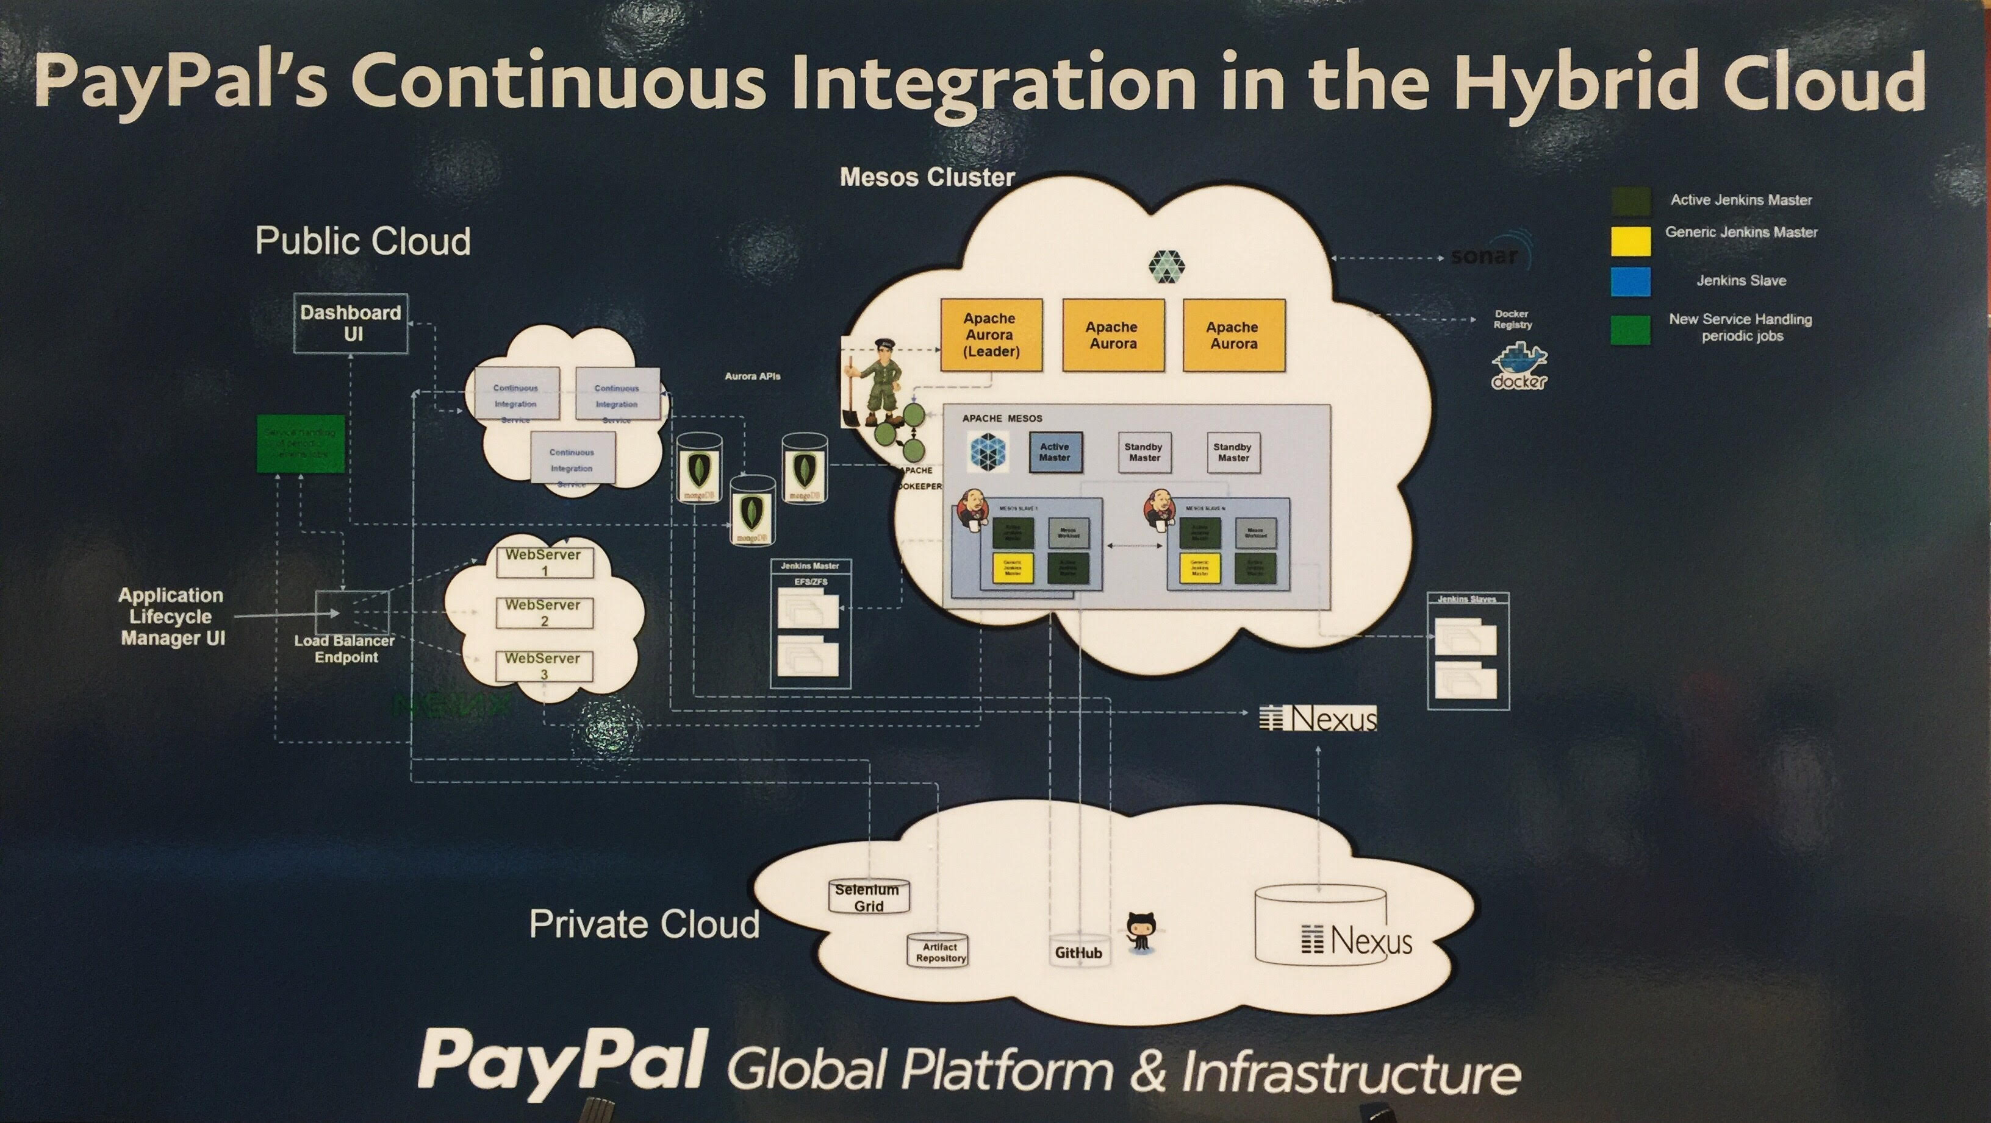
According to PayPal
Notes:
Continuous Delivery and DevOps Reference Architectures include many common tool choices. The most common tool choices we find in these reference architectures are: Eclipse, git, Cloudbees Jenkins / Atlassian Bamboo, Sonatype Nexus, Atlassian JIRA, SonarQube, Puppet, Chef, Rundeck, Maven / Ant / Gradle, Subversion (svn), Junit, LiveRebel, ServiceNow

Slide 5

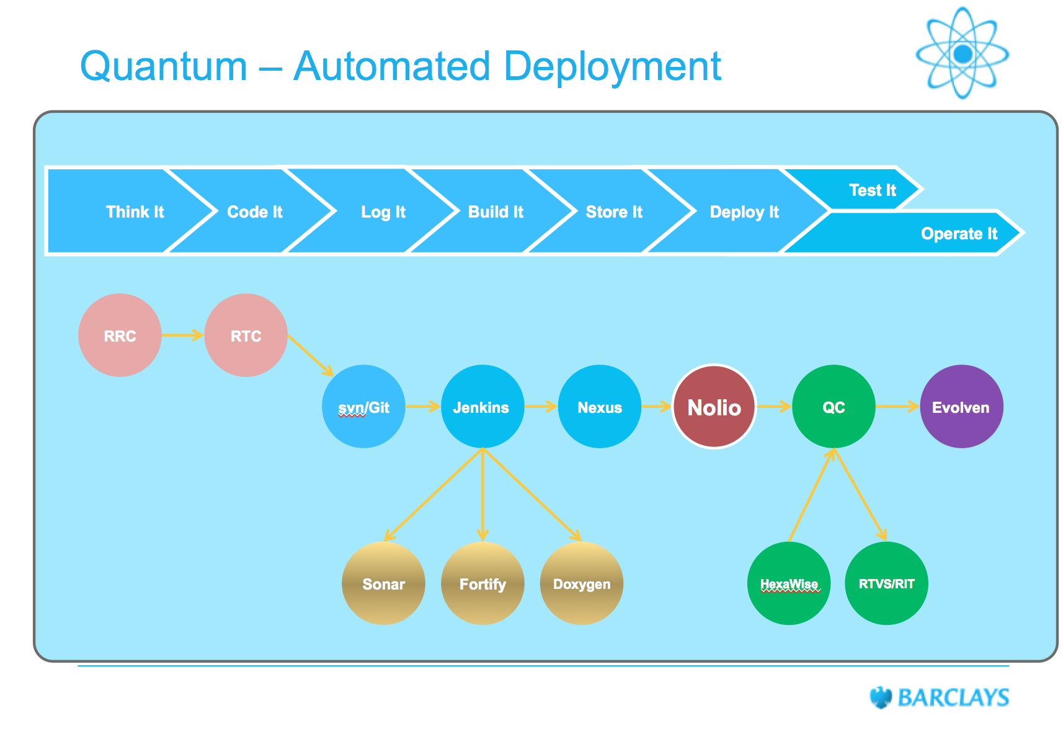
According to BARCLAYS
Source: http://bit.ly/244G39w
Notes:
Continuous Delivery and DevOps Reference Architectures include many common tool choices. The most common tool choices we find in these reference architectures are: Eclipse, git, Cloudbees Jenkins / Atlassian Bamboo, Sonatype Nexus, Atlassian JIRA, SonarQube, Puppet, Chef, Rundeck, Maven / Ant / Gradle, Subversion (svn), Junit, LiveRebel, ServiceNow

Slide 6

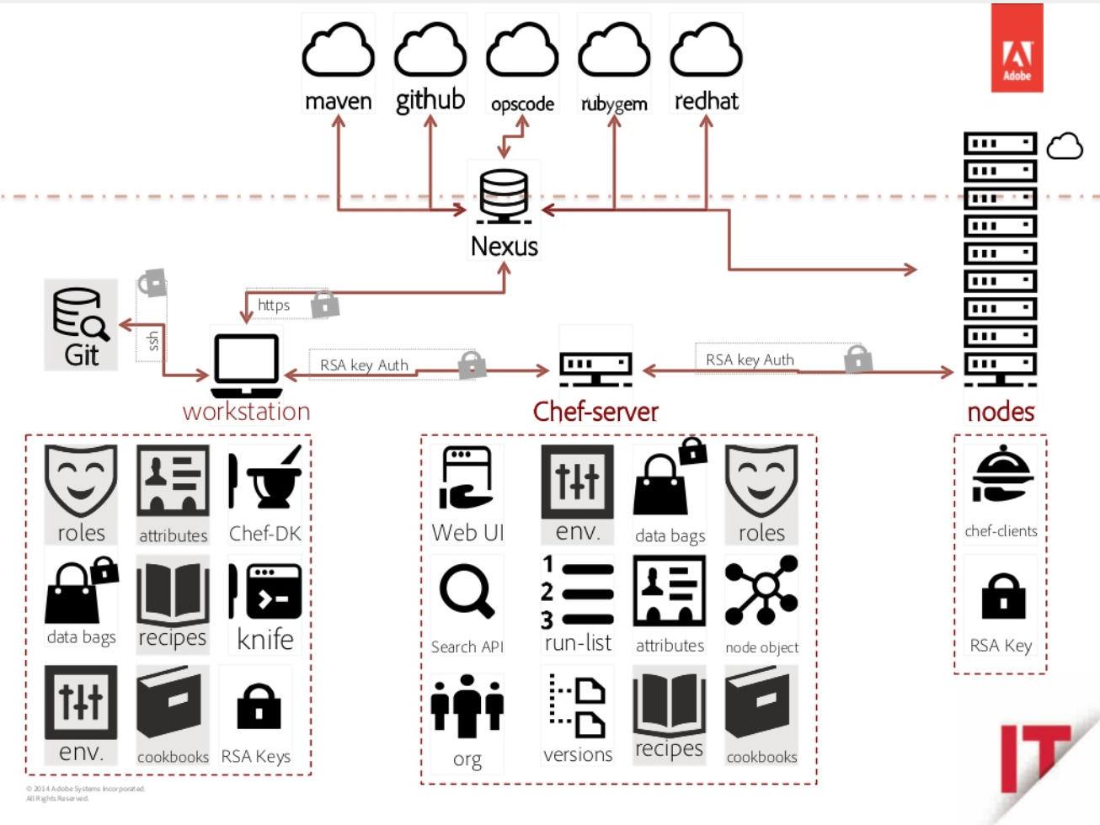
According to Adobe
Link to Presentation: Master Chef Class
http://bit.ly/1sN6o0u
Notes:
Continuous Delivery and DevOps Reference Architectures include many common tool choices. The most common tool choices we find in these reference architectures are: Eclipse, git, Cloudbees Jenkins / Atlassian Bamboo, Sonatype Nexus, Atlassian JIRA, SonarQube, Puppet, Chef, Rundeck, Maven / Ant / Gradle, Subversion (svn), Junit, LiveRebel, ServiceNow

Slide 7

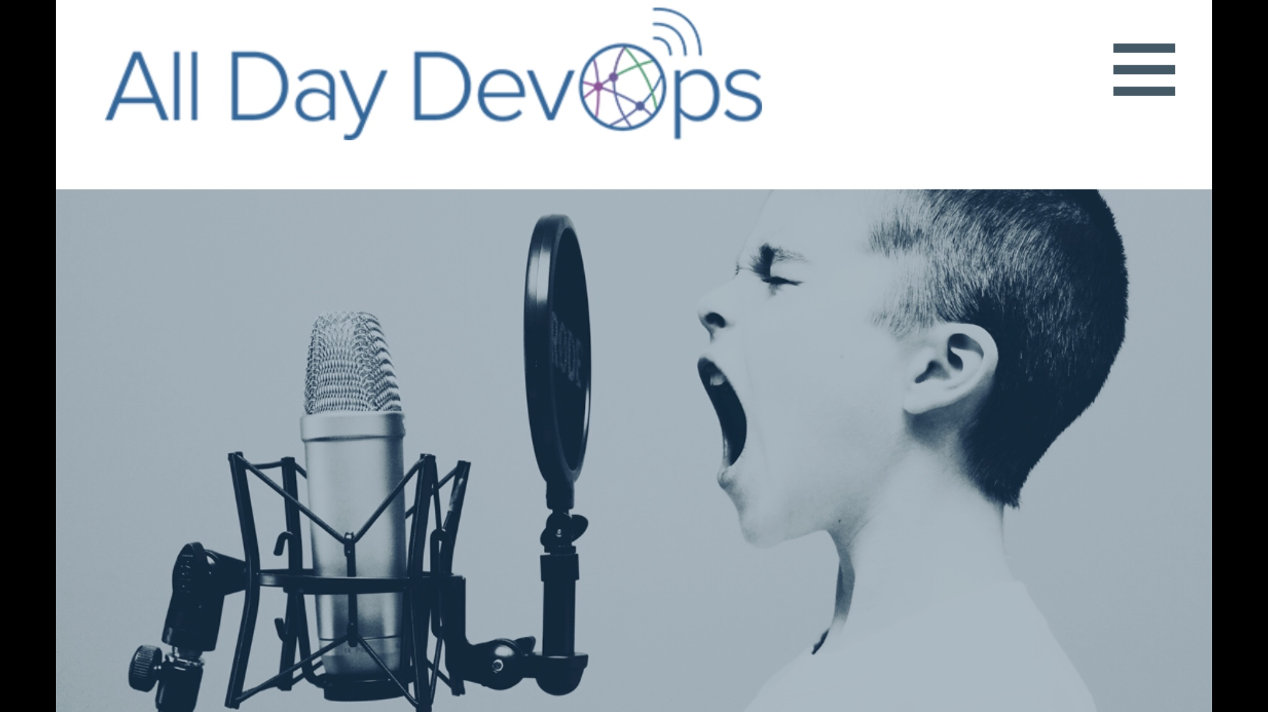

57 sessions. 15 Time Zones. 15 Hours. Nov 15. Register for Free @ www.AllDayDevOps.com
Notes:
Last year, we jump-started thousands of DevOps journeys. And we validated many more. We did this by publishing 31 DevOps and Continuous Delivery reference architectures. These reference sheets have now been viewed more than 70,000 times. Some are simple, some complex. But all from the real world.

Slide 8

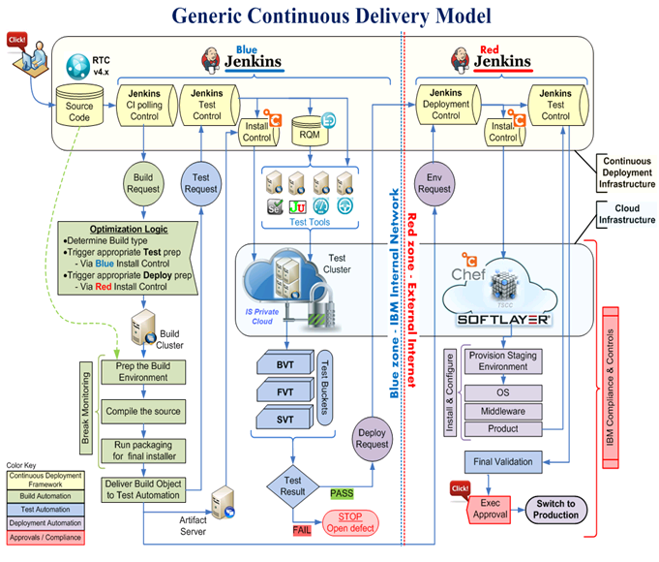
According to IBM
Source: http://ibm.co/22maoB3
Notes:
Continuous Delivery and DevOps Reference Architectures include many common tool choices. The most common tool choices we find in these reference architectures are: Eclipse, git, Cloudbees Jenkins / Atlassian Bamboo, Sonatype Nexus, Atlassian JIRA, SonarQube, Puppet, Chef, Rundeck, Maven / Ant / Gradle, Subversion (svn), Junit, LiveRebel, ServiceNow

Slide 9
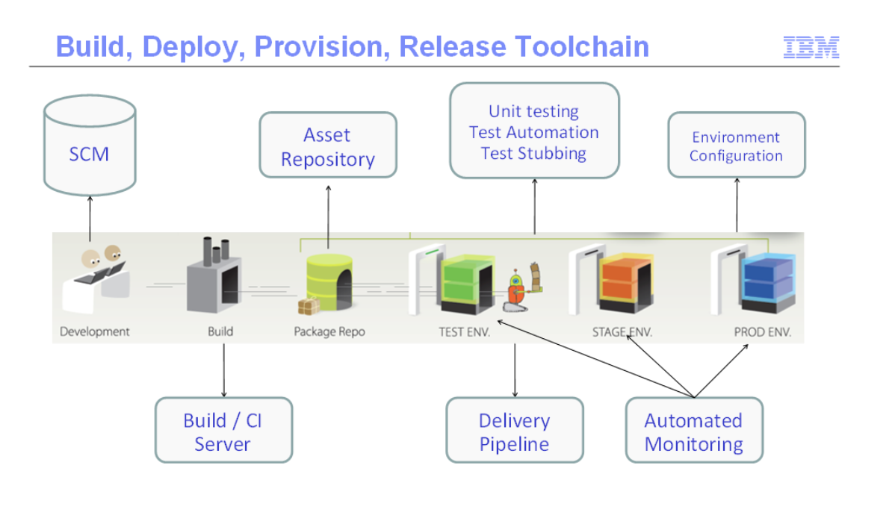
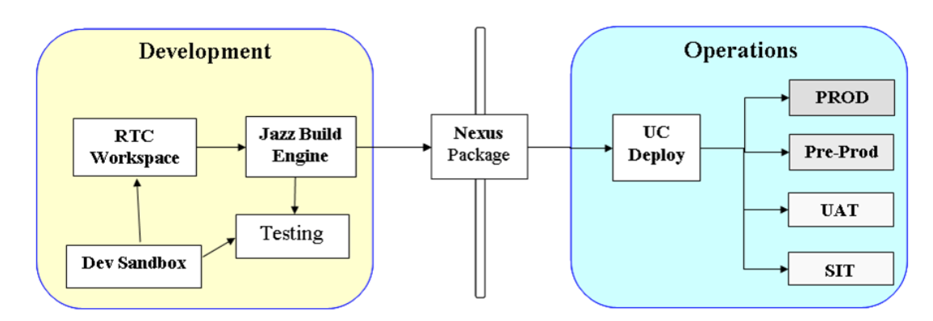
According to IBM
Link to Blog: DevOps Best Practice
http://ibm.co/27QQq5i
Notes:
Continuous Delivery and DevOps Reference Architectures include many common tool choices. The most common tool choices we find in these reference architectures are: Eclipse, git, Cloudbees Jenkins / Atlassian Bamboo, Sonatype Nexus, Atlassian JIRA, SonarQube, Puppet, Chef, Rundeck, Maven / Ant / Gradle, Subversion (svn), Junit, LiveRebel, ServiceNow

Slide 10

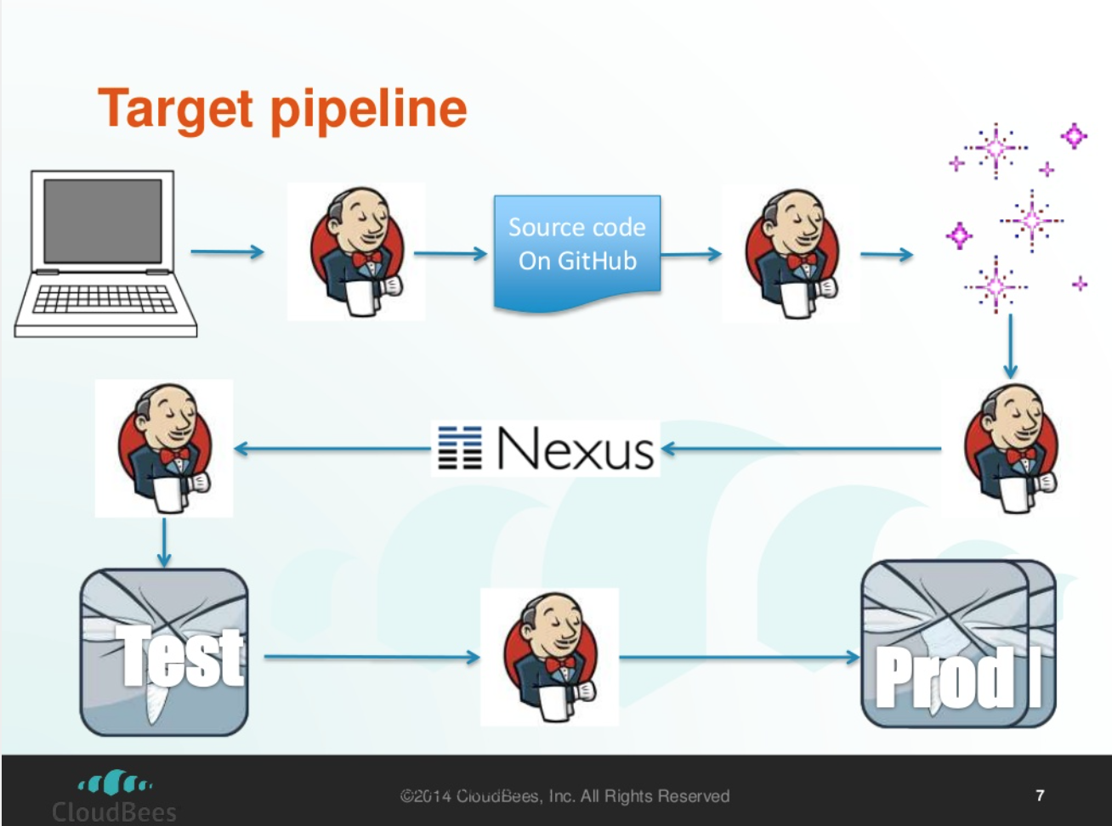
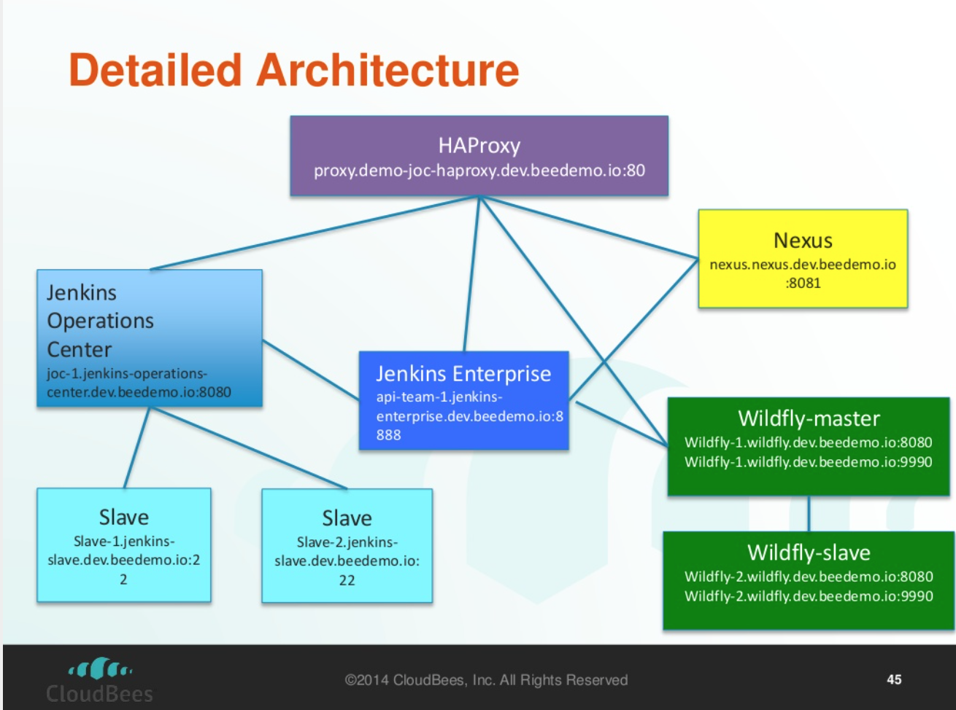
According to Cloudbees
Link to Presentation: Continuous Delivery
http://bit.ly/1YSreFu
Notes:
Continuous Delivery and DevOps Reference Architectures include many common tool choices. The most common tool choices we find in these reference architectures are: Eclipse, git, Cloudbees Jenkins / Atlassian Bamboo, Sonatype Nexus, Atlassian JIRA, SonarQube, Puppet, Chef, Rundeck, Maven / Ant / Gradle, Subversion (svn), Junit, LiveRebel, ServiceNow

Slide 11

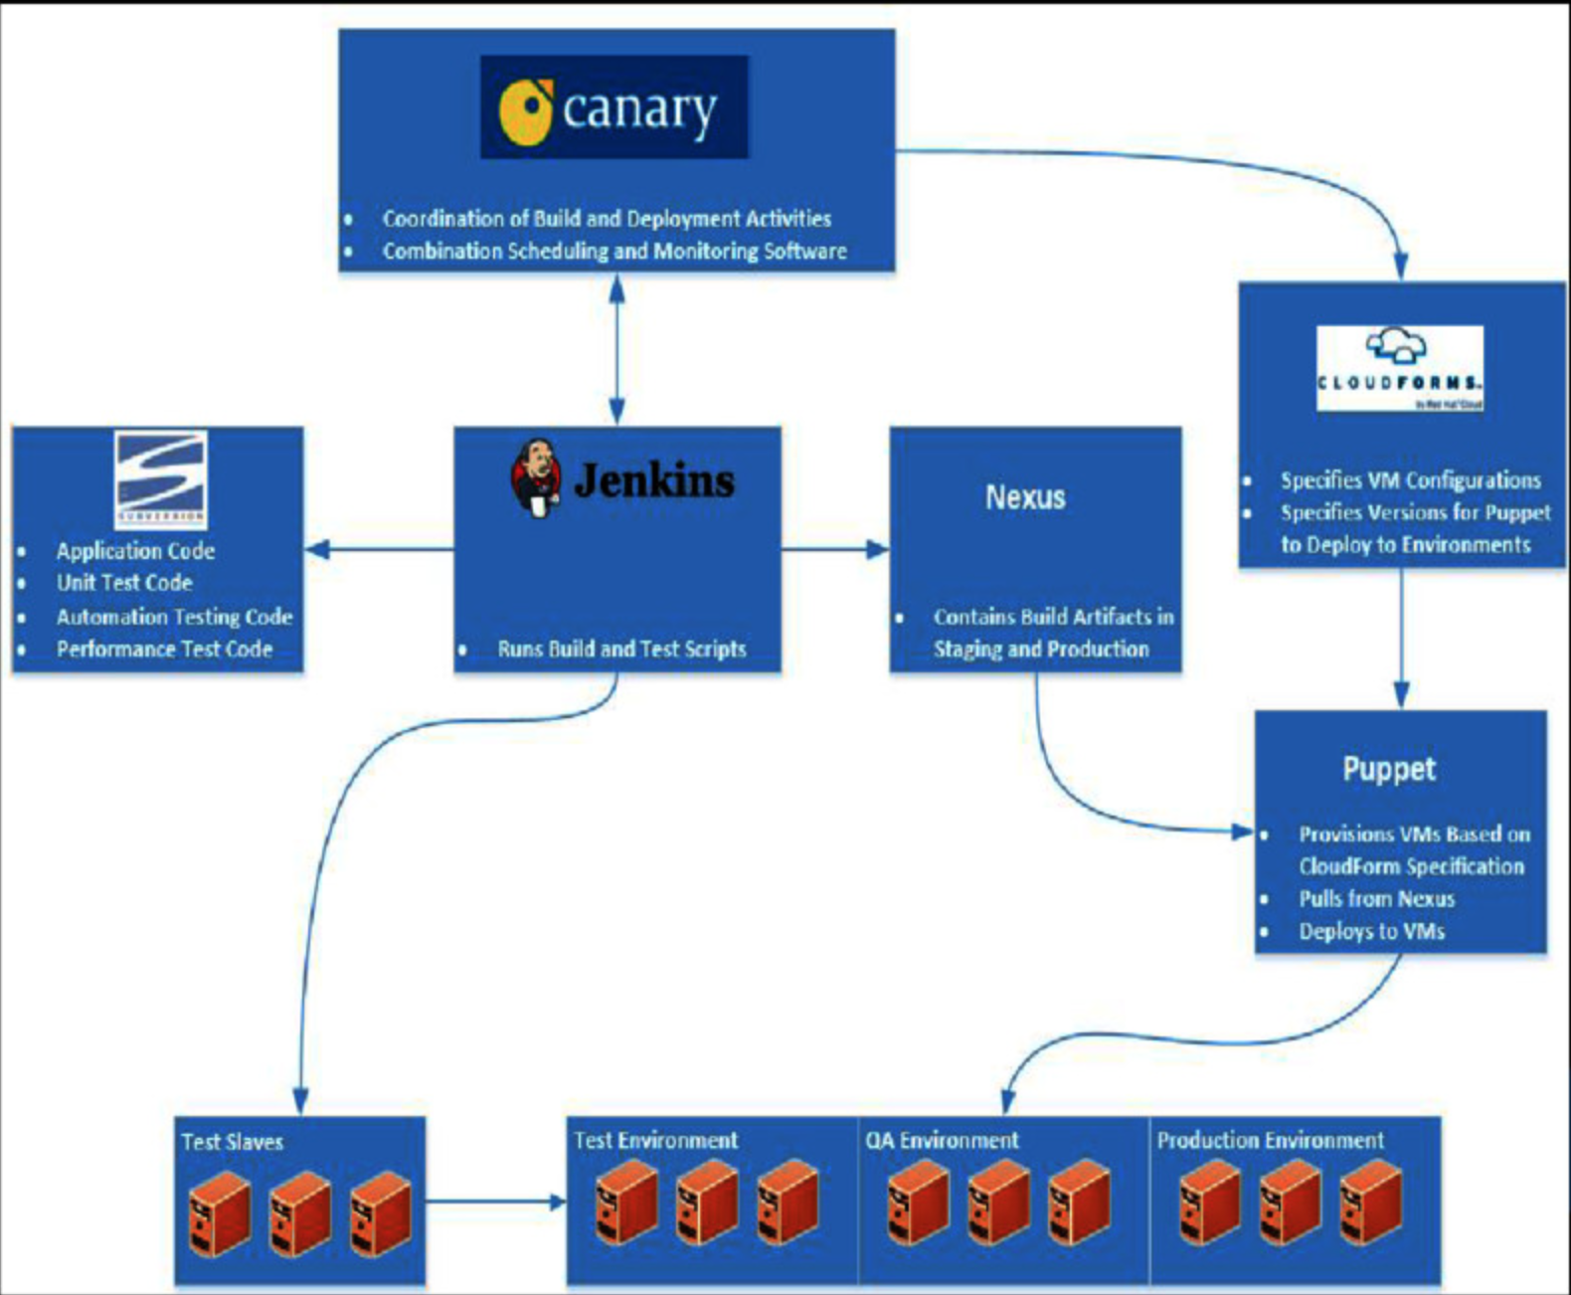
According to US Patent & Trade Office (USPTO)
Link to Presentation: DevOps and American Innovation
http://bit.ly/1qF8qxS
Notes:
Continuous Delivery and DevOps Reference Architectures include many common tool choices. The most common tool choices we find in these reference architectures are: Eclipse, git, Cloudbees Jenkins / Atlassian Bamboo, Sonatype Nexus, Atlassian JIRA, SonarQube, Puppet, Chef, Rundeck, Maven / Ant / Gradle, Subversion (svn), Junit, LiveRebel, ServiceNow

Slide 12

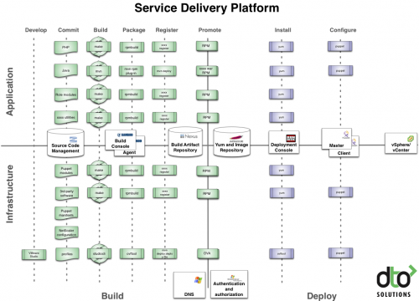
According to Rundeck
Link to Blog: What is DevOps
http://bit.ly/1sxSm2g
Notes:
Continuous Delivery and DevOps Reference Architectures include many common tool choices. The most common tool choices we find in these reference architectures are: Eclipse, git, Cloudbees Jenkins / Atlassian Bamboo, Sonatype Nexus, Atlassian JIRA, SonarQube, Puppet, Chef, Rundeck, Maven / Ant / Gradle, Subversion (svn), Junit, LiveRebel, ServiceNow

Slide 13
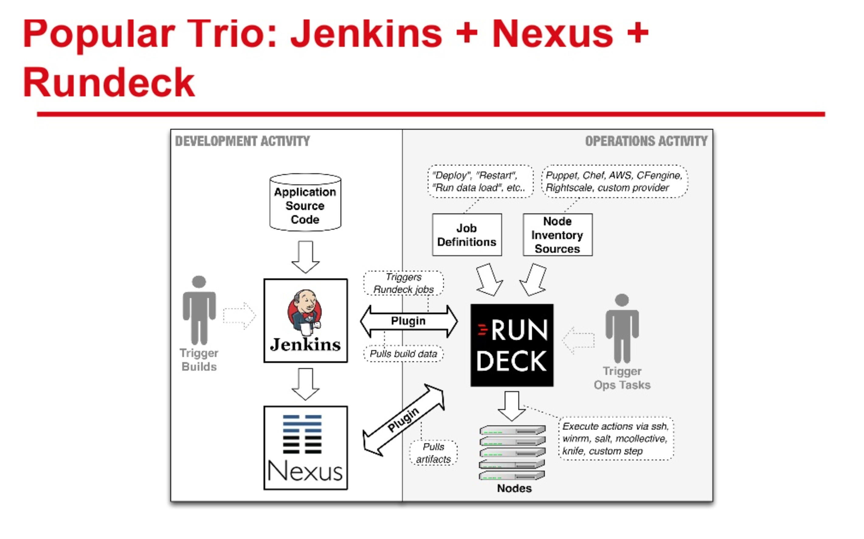
According to Rundeck
Link to Presentation: Rundeck + Nexus
http://bit.ly/1WKSR5B
Notes:
Continuous Delivery and DevOps Reference Architectures include many common tool choices. The most common tool choices we find in these reference architectures are: Eclipse, git, Cloudbees Jenkins / Atlassian Bamboo, Sonatype Nexus, Atlassian JIRA, SonarQube, Puppet, Chef, Rundeck, Maven / Ant / Gradle, Subversion (svn), Junit, LiveRebel, ServiceNow

Slide 14

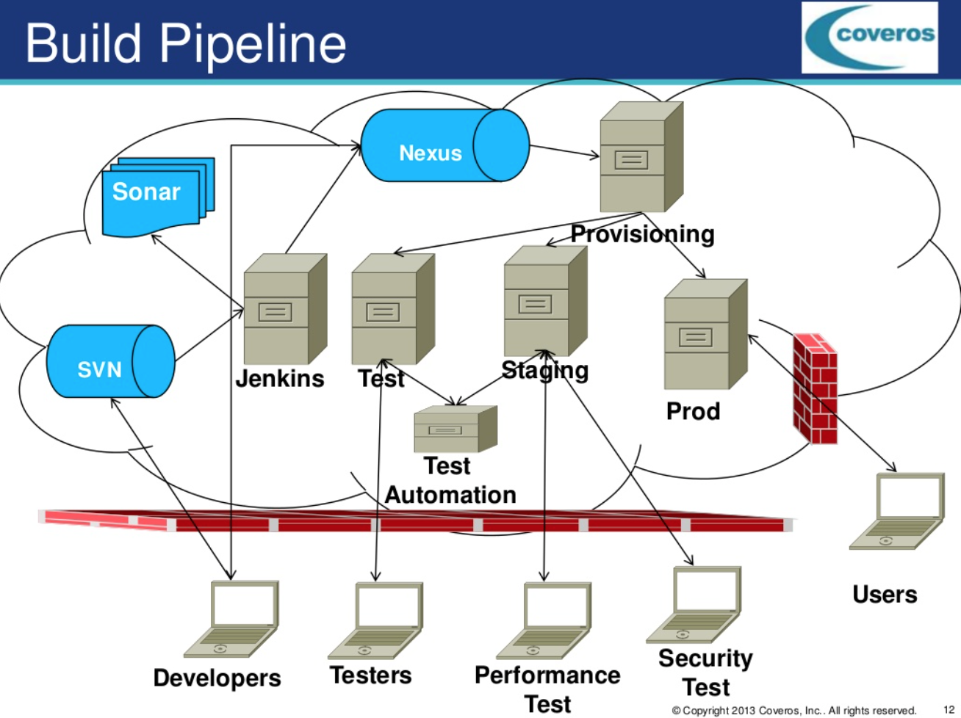
According to Coveros
Link to Presentation: Overcoming problems
http://bit.ly/27QQNNv
Notes:
Continuous Delivery and DevOps Reference Architectures include many common tool choices. The most common tool choices we find in these reference architectures are: Eclipse, git, Cloudbees Jenkins / Atlassian Bamboo, Sonatype Nexus, Atlassian JIRA, SonarQube, Puppet, Chef, Rundeck, Maven / Ant / Gradle, Subversion (svn), Junit, LiveRebel, ServiceNow

Slide 15

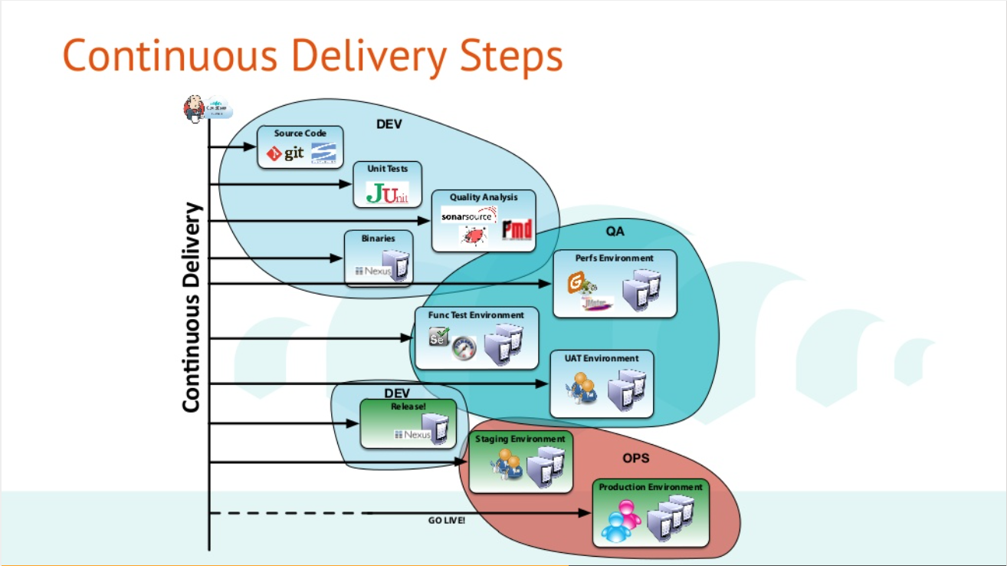
According to Xebia
Link to Presentation: Journée DevOps
http://bit.ly/1XNMTAp
Notes:
Continuous Delivery and DevOps Reference Architectures include many common tool choices. The most common tool choices we find in these reference architectures are: Eclipse, git, Cloudbees Jenkins / Atlassian Bamboo, Sonatype Nexus, Atlassian JIRA, SonarQube, Puppet, Chef, Rundeck, Maven / Ant / Gradle, Subversion (svn), Junit, LiveRebel, ServiceNow

Slide 16

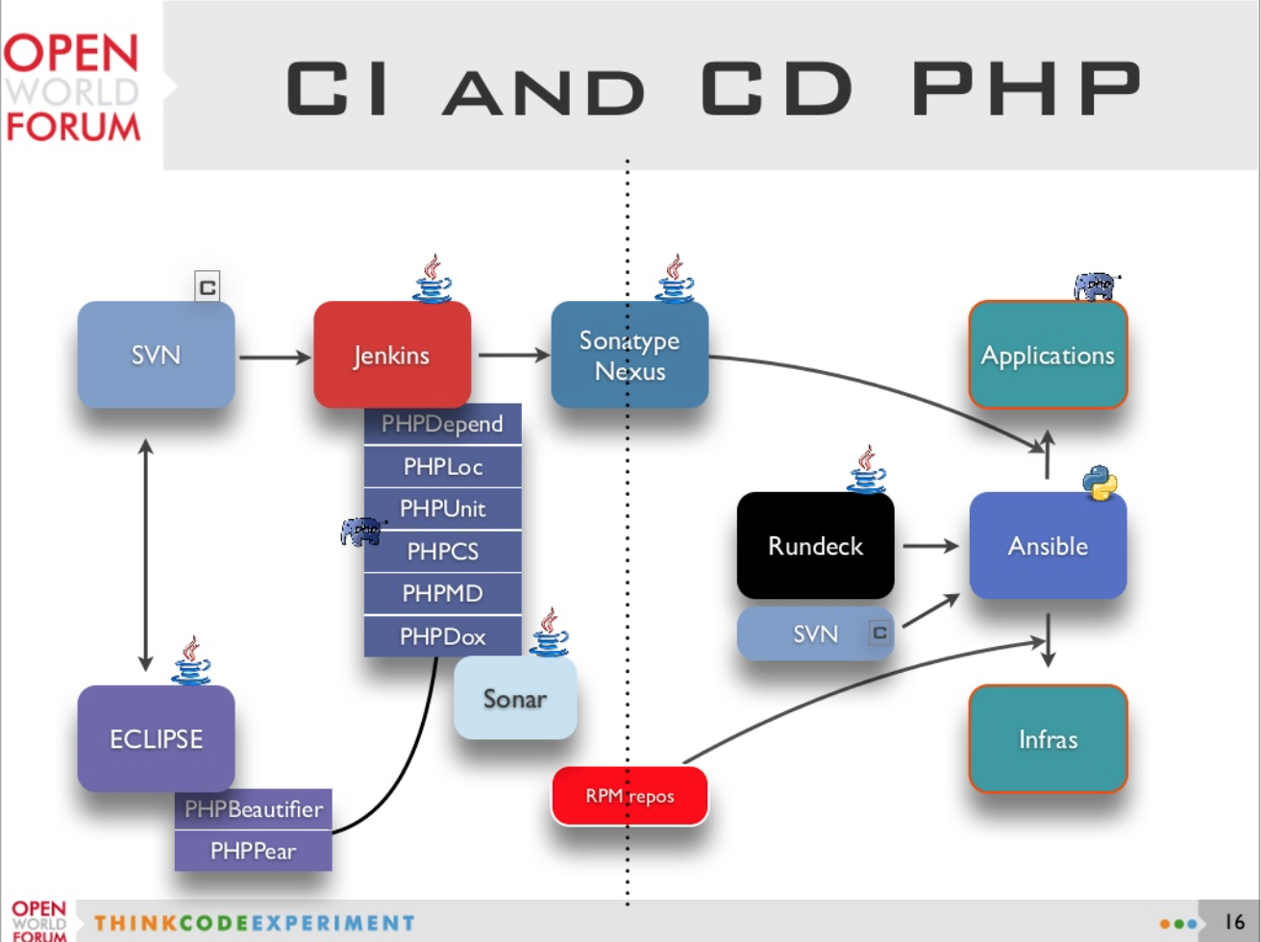
Nexus at Alter Way
Link to Presentation: Agnostic Continuous Delivery
http://bit.ly/1U9tHKu
Notes:
Continuous Delivery and DevOps Reference Architectures include many common tool choices. The most common tool choices we find in these reference architectures are: Eclipse, git, Cloudbees Jenkins / Atlassian Bamboo, Sonatype Nexus, Atlassian JIRA, SonarQube, Puppet, Chef, Rundeck, Maven / Ant / Gradle, Subversion (svn), Junit, LiveRebel, ServiceNow

Slide 17

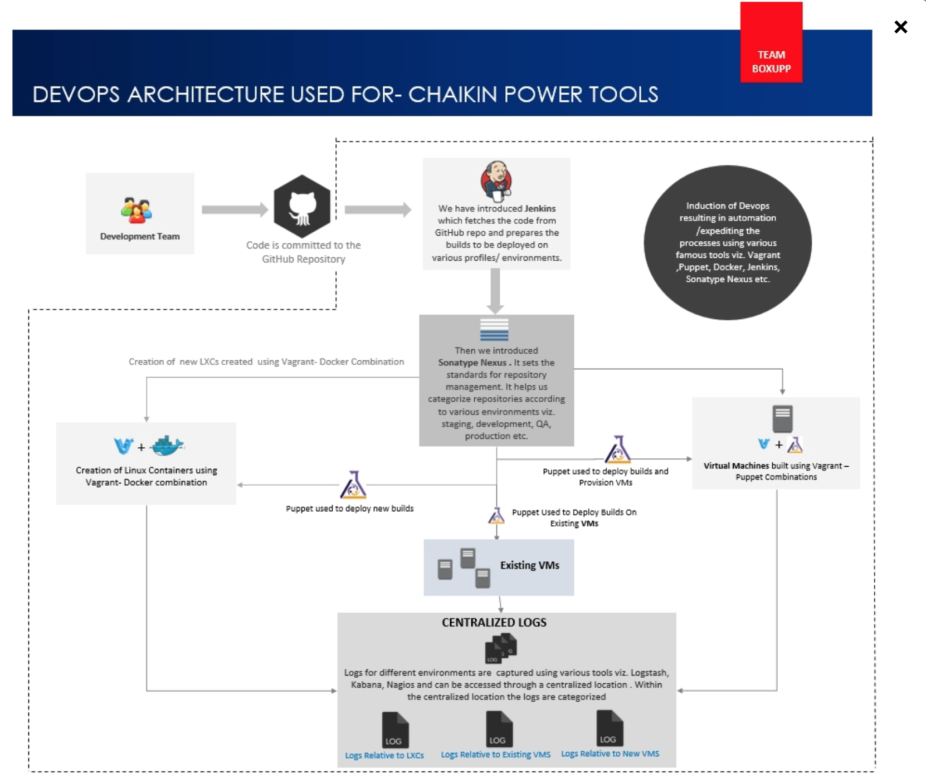
According to Boxupp
Link to Blog: A DevOps Perspective
http://bit.ly/27QQBxM
Notes:
Continuous Delivery and DevOps Reference Architectures include many common tool choices. The most common tool choices we find in these reference architectures are: Eclipse, git, Cloudbees Jenkins / Atlassian Bamboo, Sonatype Nexus, Atlassian JIRA, SonarQube, Puppet, Chef, Rundeck, Maven / Ant / Gradle, Subversion (svn), Junit, LiveRebel, ServiceNow

Slide 18

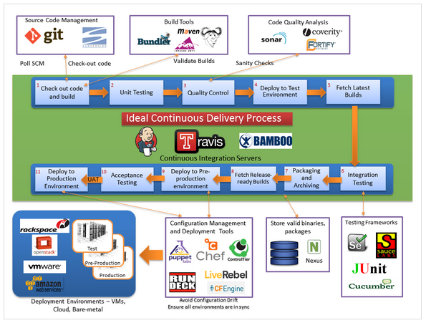
According to bogotobogo
Source: http://bit.ly/1Tv0305
Notes:
Continuous Delivery and DevOps Reference Architectures include many common tool choices. The most common tool choices we find in these reference architectures are: Eclipse, git, Cloudbees Jenkins / Atlassian Bamboo, Sonatype Nexus, Atlassian JIRA, SonarQube, Puppet, Chef, Rundeck, Maven / Ant / Gradle, Subversion (svn), Junit, LiveRebel, ServiceNow

Slide 19

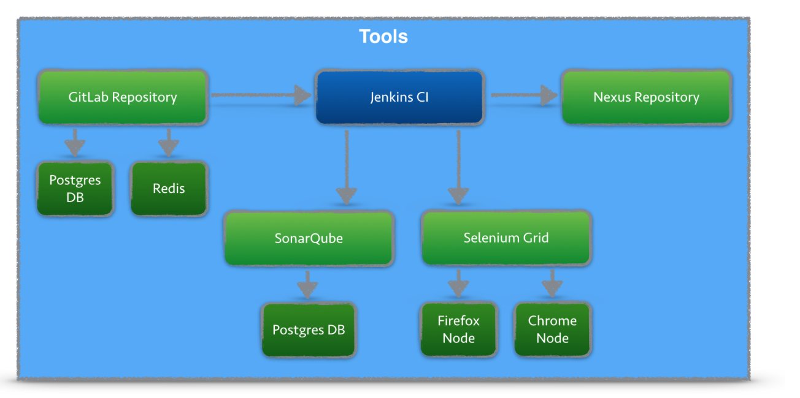
According to codecentric
Continuous Integration Platform Using Docker Containers: Jenkins, SonarQube, Nexus, GitLab
Source: DevOps & Security
http://bit.ly/1WNJvqh
Notes:
Continuous Delivery and DevOps Reference Architectures include many common tool choices. The most common tool choices we find in these reference architectures are: Eclipse, git, Cloudbees Jenkins / Atlassian Bamboo, Sonatype Nexus, Atlassian JIRA, SonarQube, Puppet, Chef, Rundeck, Maven / Ant / Gradle, Subversion (svn), Junit, LiveRebel, ServiceNow

Slide 20
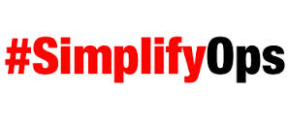
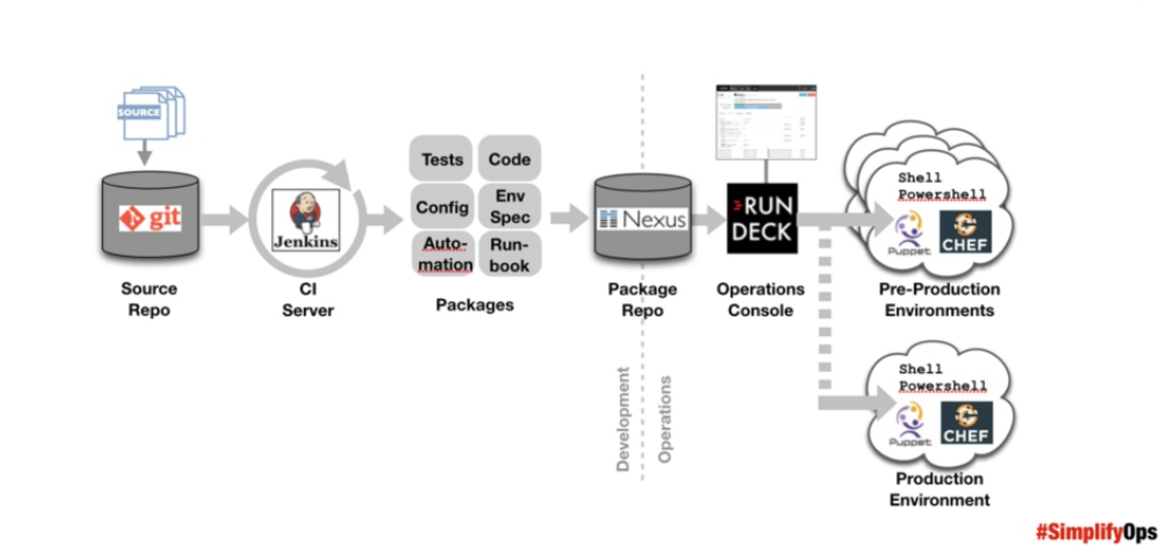
According to SimplifyOps
Source: DevOps & Security
http://bit.ly/1WNJvqh
Notes:
Continuous Delivery and DevOps Reference Architectures include many common tool choices. The most common tool choices we find in these reference architectures are: Eclipse, git, Cloudbees Jenkins / Atlassian Bamboo, Sonatype Nexus, Atlassian JIRA, SonarQube, Puppet, Chef, Rundeck, Maven / Ant / Gradle, Subversion (svn), Junit, LiveRebel, ServiceNow

Slide 21

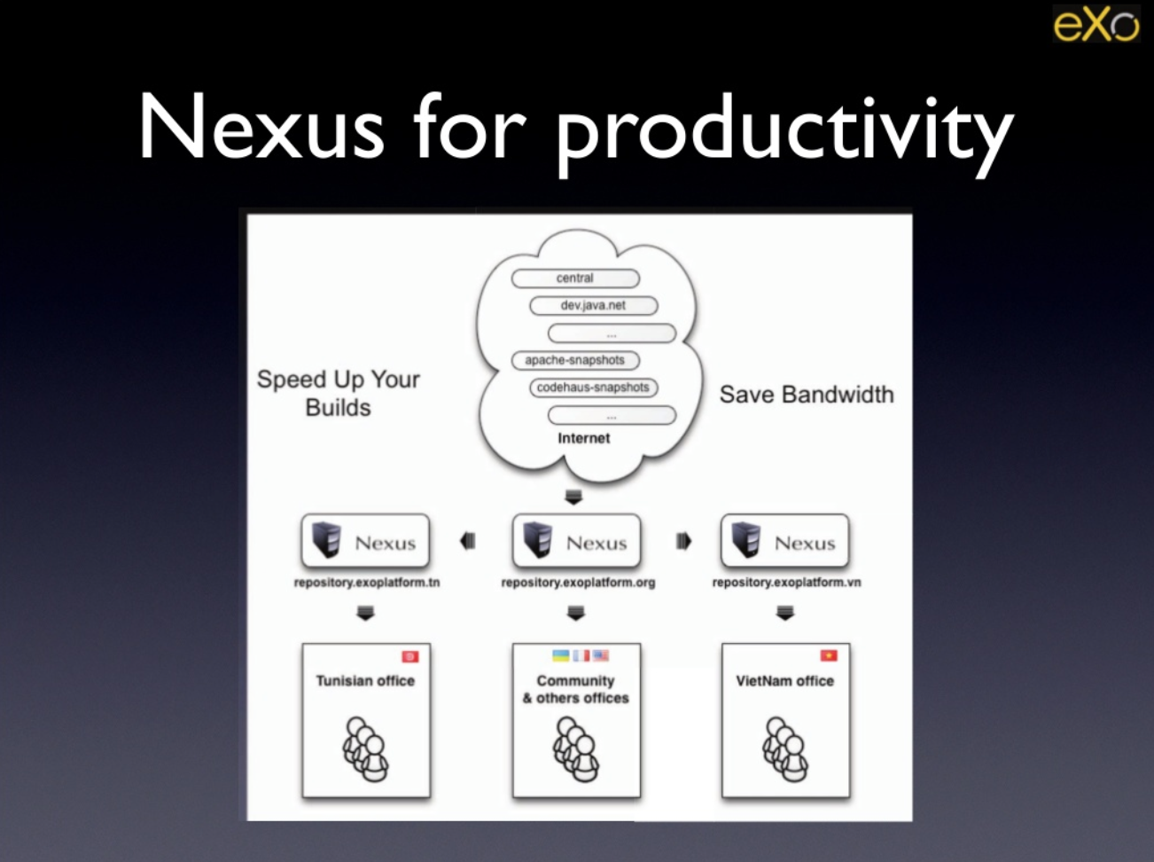
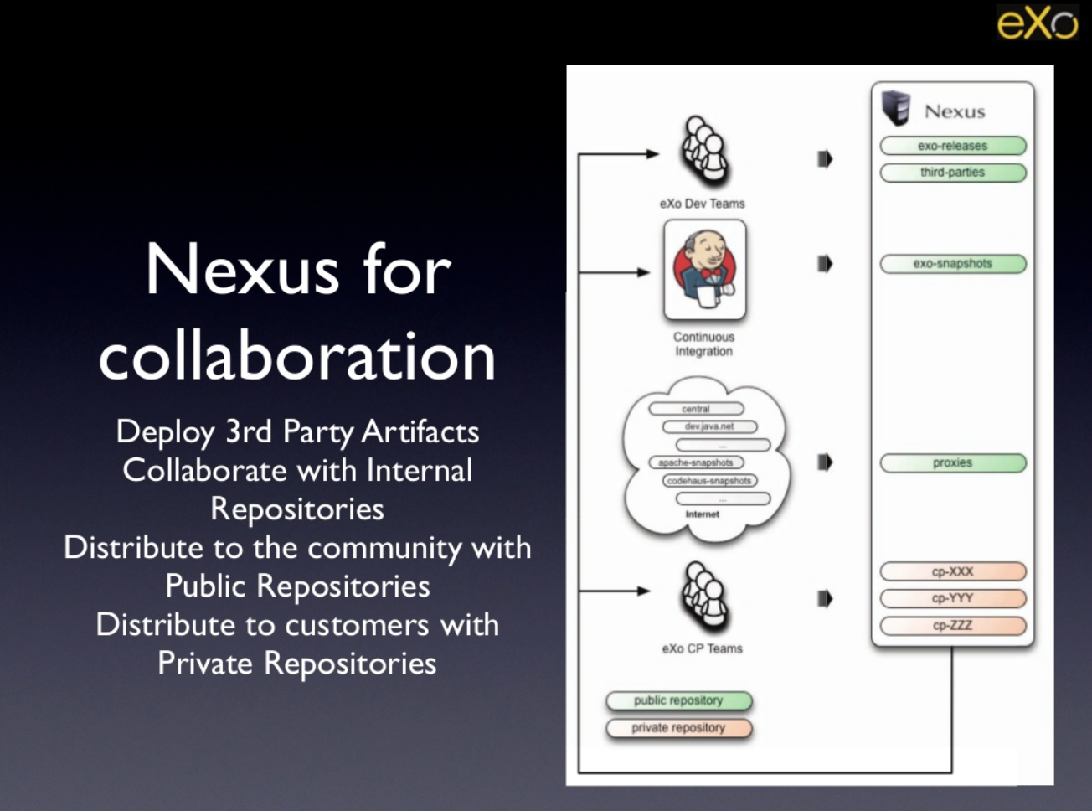
According to eXo Software
Link to Presentation: eXo Software Factory Overview
http://bit.ly/1Tzd3DU
Notes:
Continuous Delivery and DevOps Reference Architectures include many common tool choices. The most common tool choices we find in these reference architectures are: Eclipse, git, Cloudbees Jenkins / Atlassian Bamboo, Sonatype Nexus, Atlassian JIRA, SonarQube, Puppet, Chef, Rundeck, Maven / Ant / Gradle, Subversion (svn), Junit, LiveRebel, ServiceNow

Slide 22

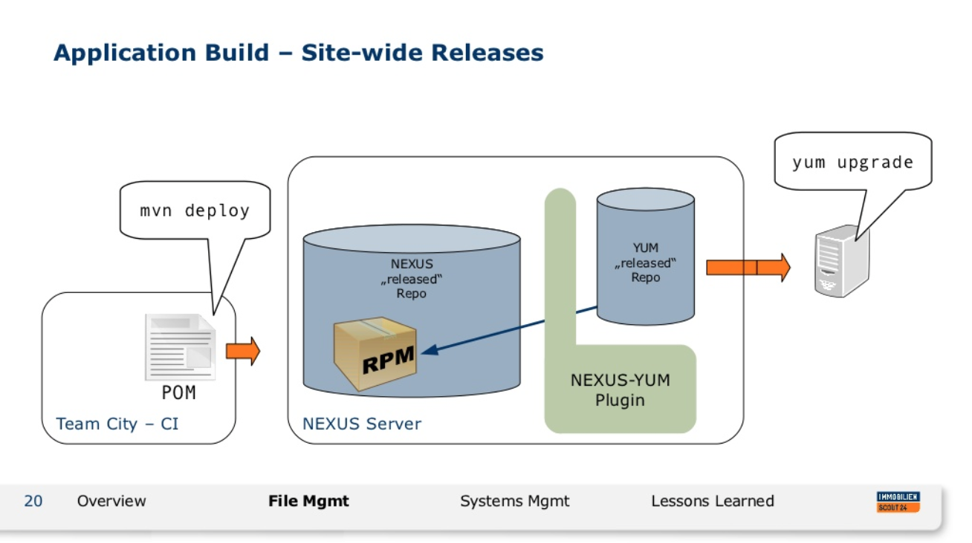
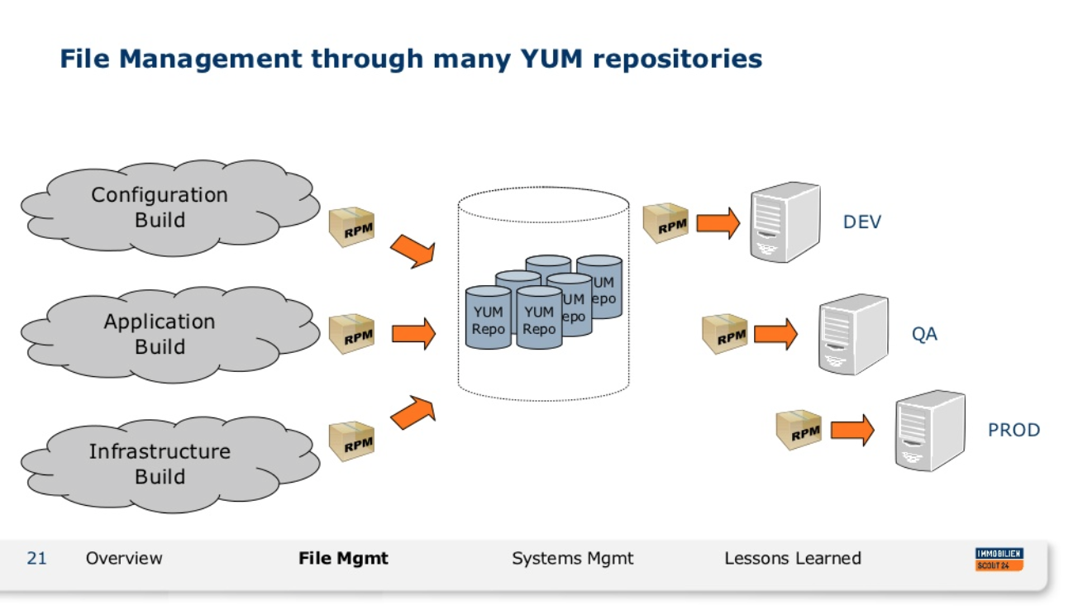
According to ImmobilienScout24
Link to Presentation: Be Fast or Stay Behind
http://bit.ly/20rGp9c
Notes:
Continuous Delivery and DevOps Reference Architectures include many common tool choices. The most common tool choices we find in these reference architectures are: Eclipse, git, Cloudbees Jenkins / Atlassian Bamboo, Sonatype Nexus, Atlassian JIRA, SonarQube, Puppet, Chef, Rundeck, Maven / Ant / Gradle, Subversion (svn), Junit, LiveRebel, ServiceNow

Slide 23

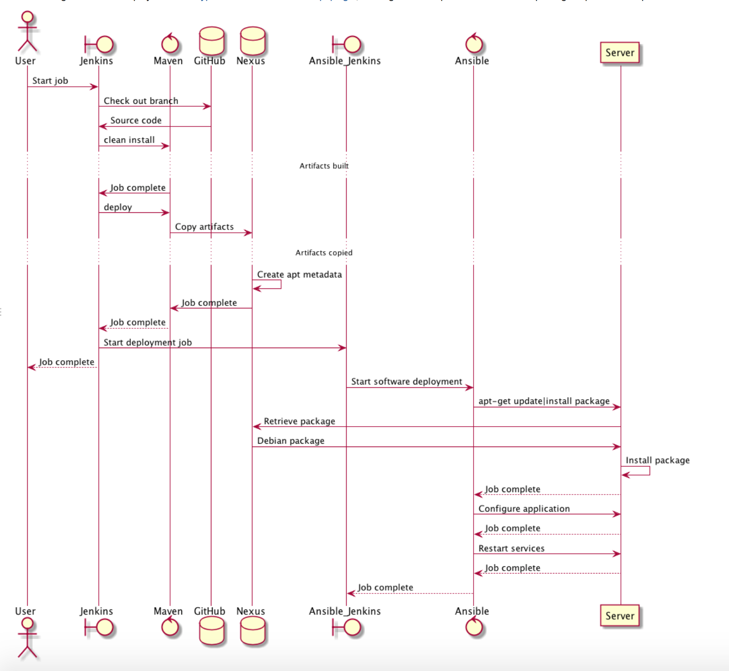
According to IHTSDO
Link to Blog: IHTSDO DevOps
http://bit.ly/1WKTGLP
Notes:
Continuous Delivery and DevOps Reference Architectures include many common tool choices. The most common tool choices we find in these reference architectures are: Eclipse, git, Cloudbees Jenkins / Atlassian Bamboo, Sonatype Nexus, Atlassian JIRA, SonarQube, Puppet, Chef, Rundeck, Maven / Ant / Gradle, Subversion (svn), Junit, LiveRebel, ServiceNow

Slide 24

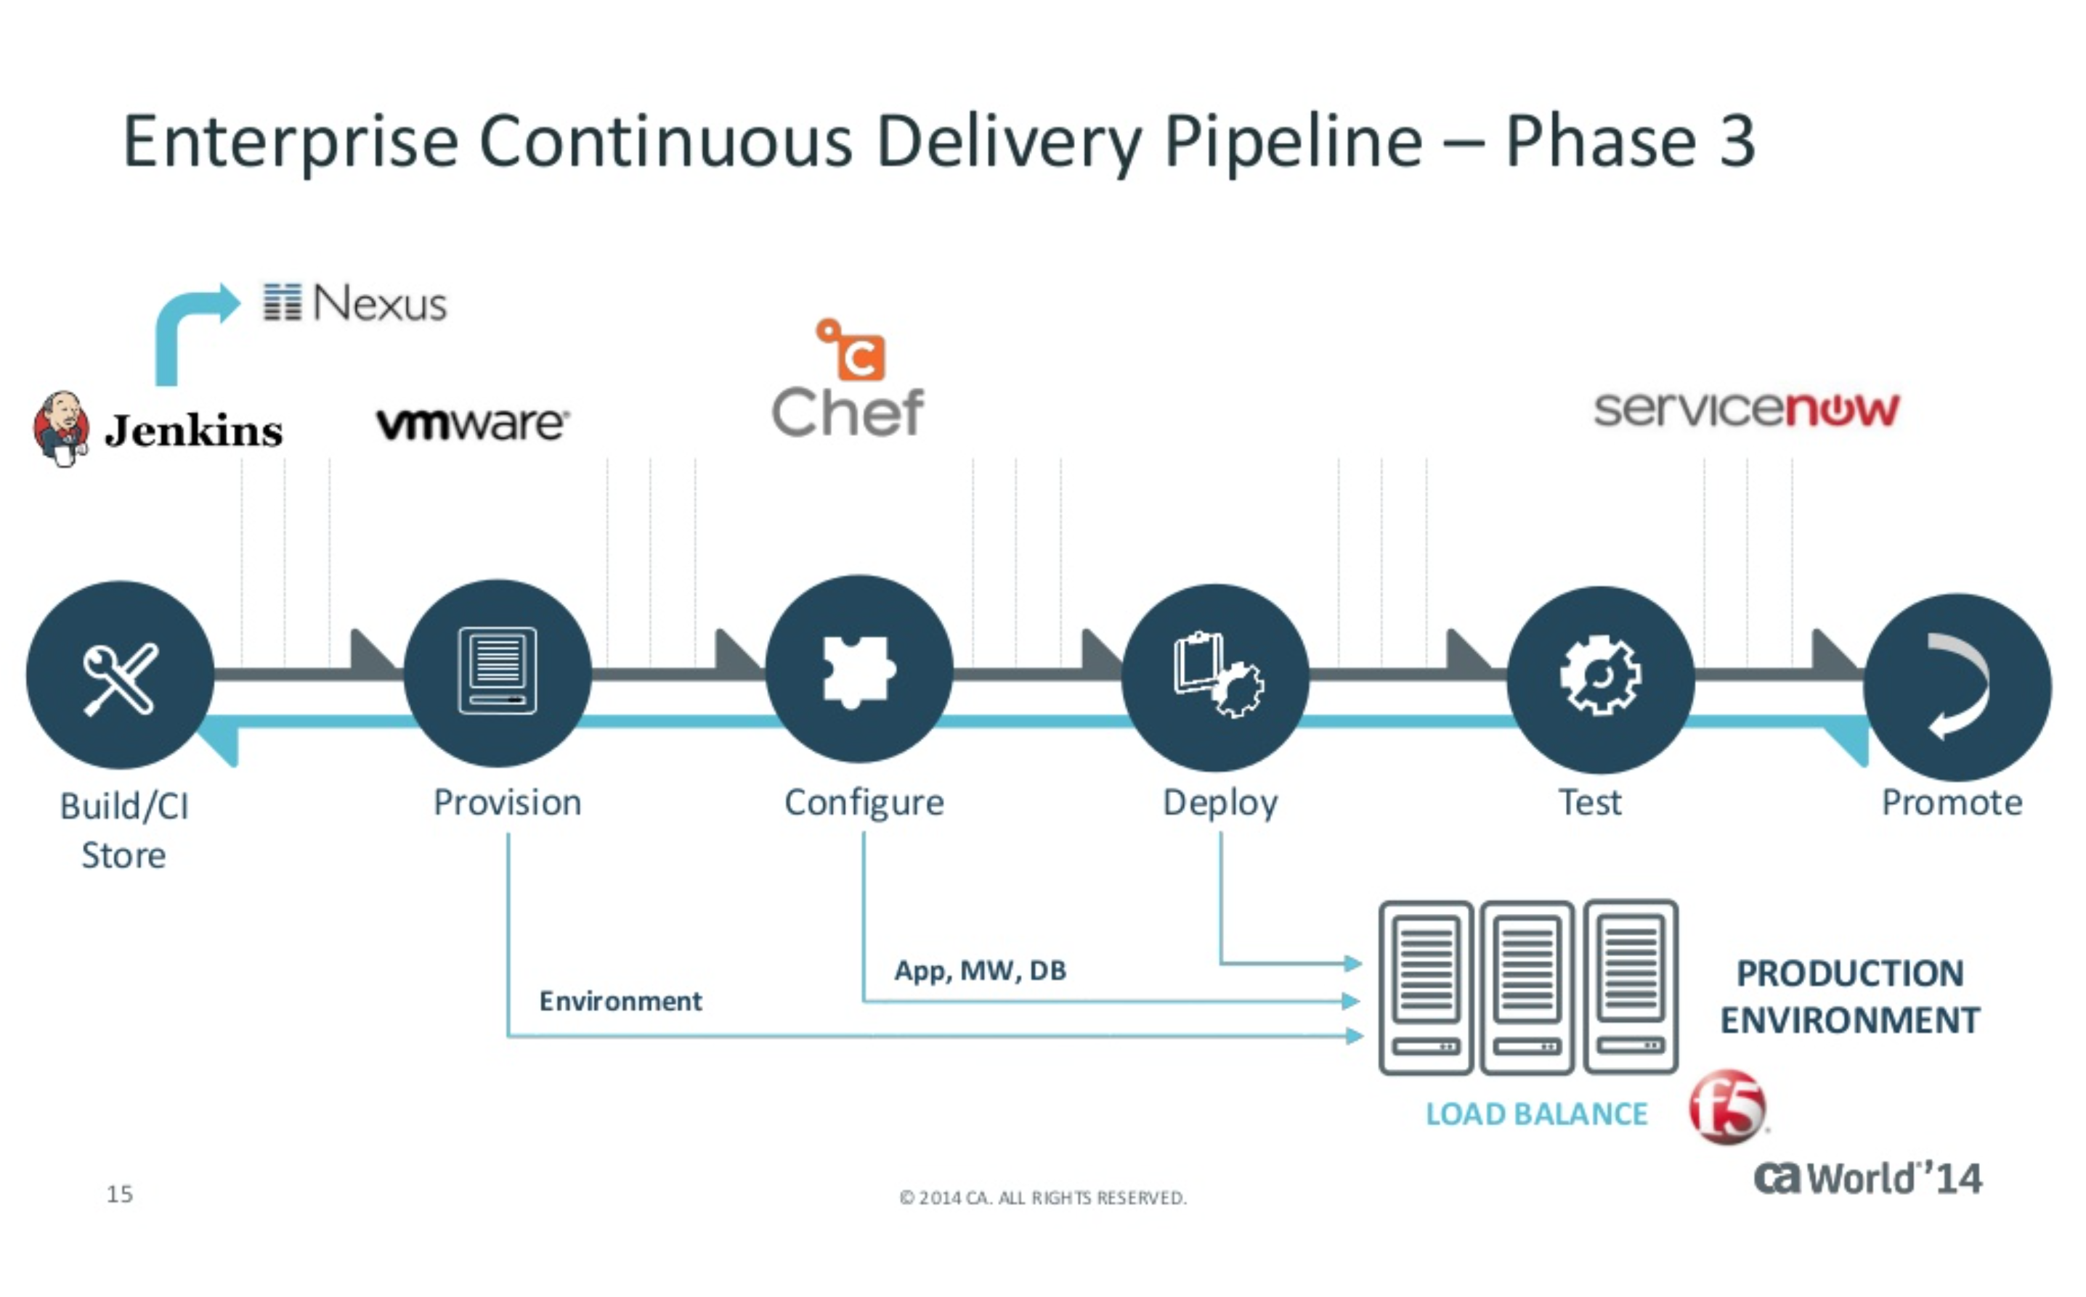
According to CA Technologies
Link to: What are the Cool Kids Doing
http://bit.ly/27QQFxh
Notes:
Continuous Delivery and DevOps Reference Architectures include many common tool choices. The most common tool choices we find in these reference architectures are: Eclipse, git, Cloudbees Jenkins / Atlassian Bamboo, Sonatype Nexus, Atlassian JIRA, SonarQube, Puppet, Chef, Rundeck, Maven / Ant / Gradle, Subversion (svn), Junit, LiveRebel, ServiceNow

Slide 25

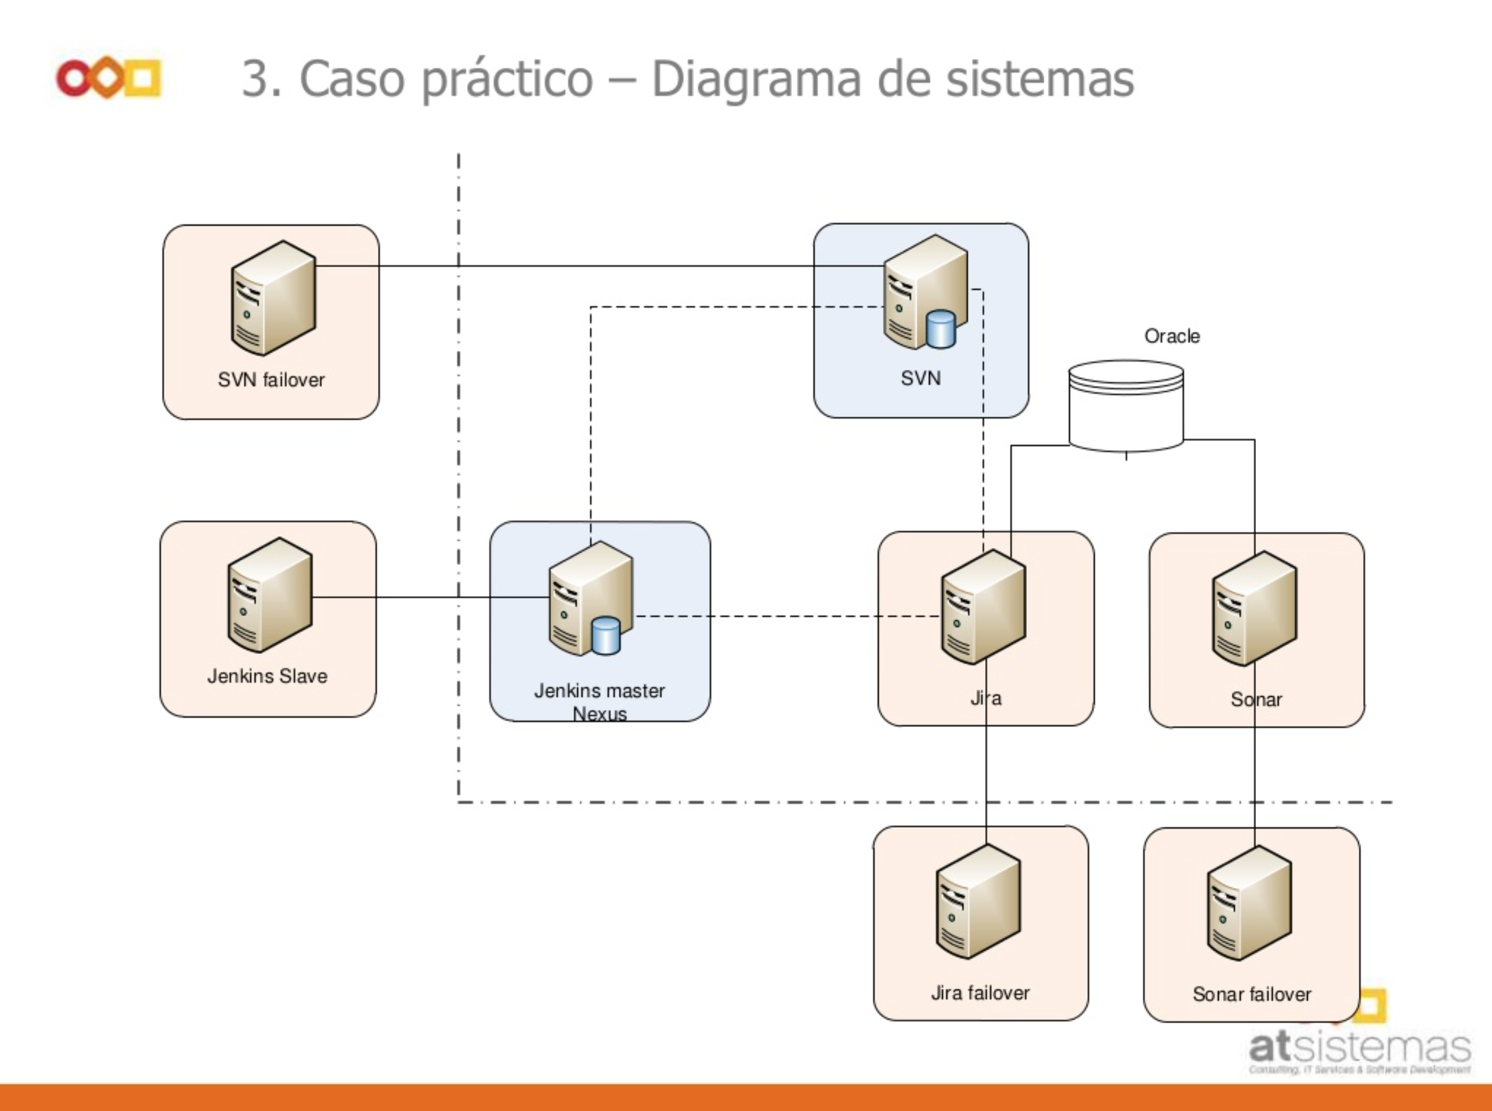
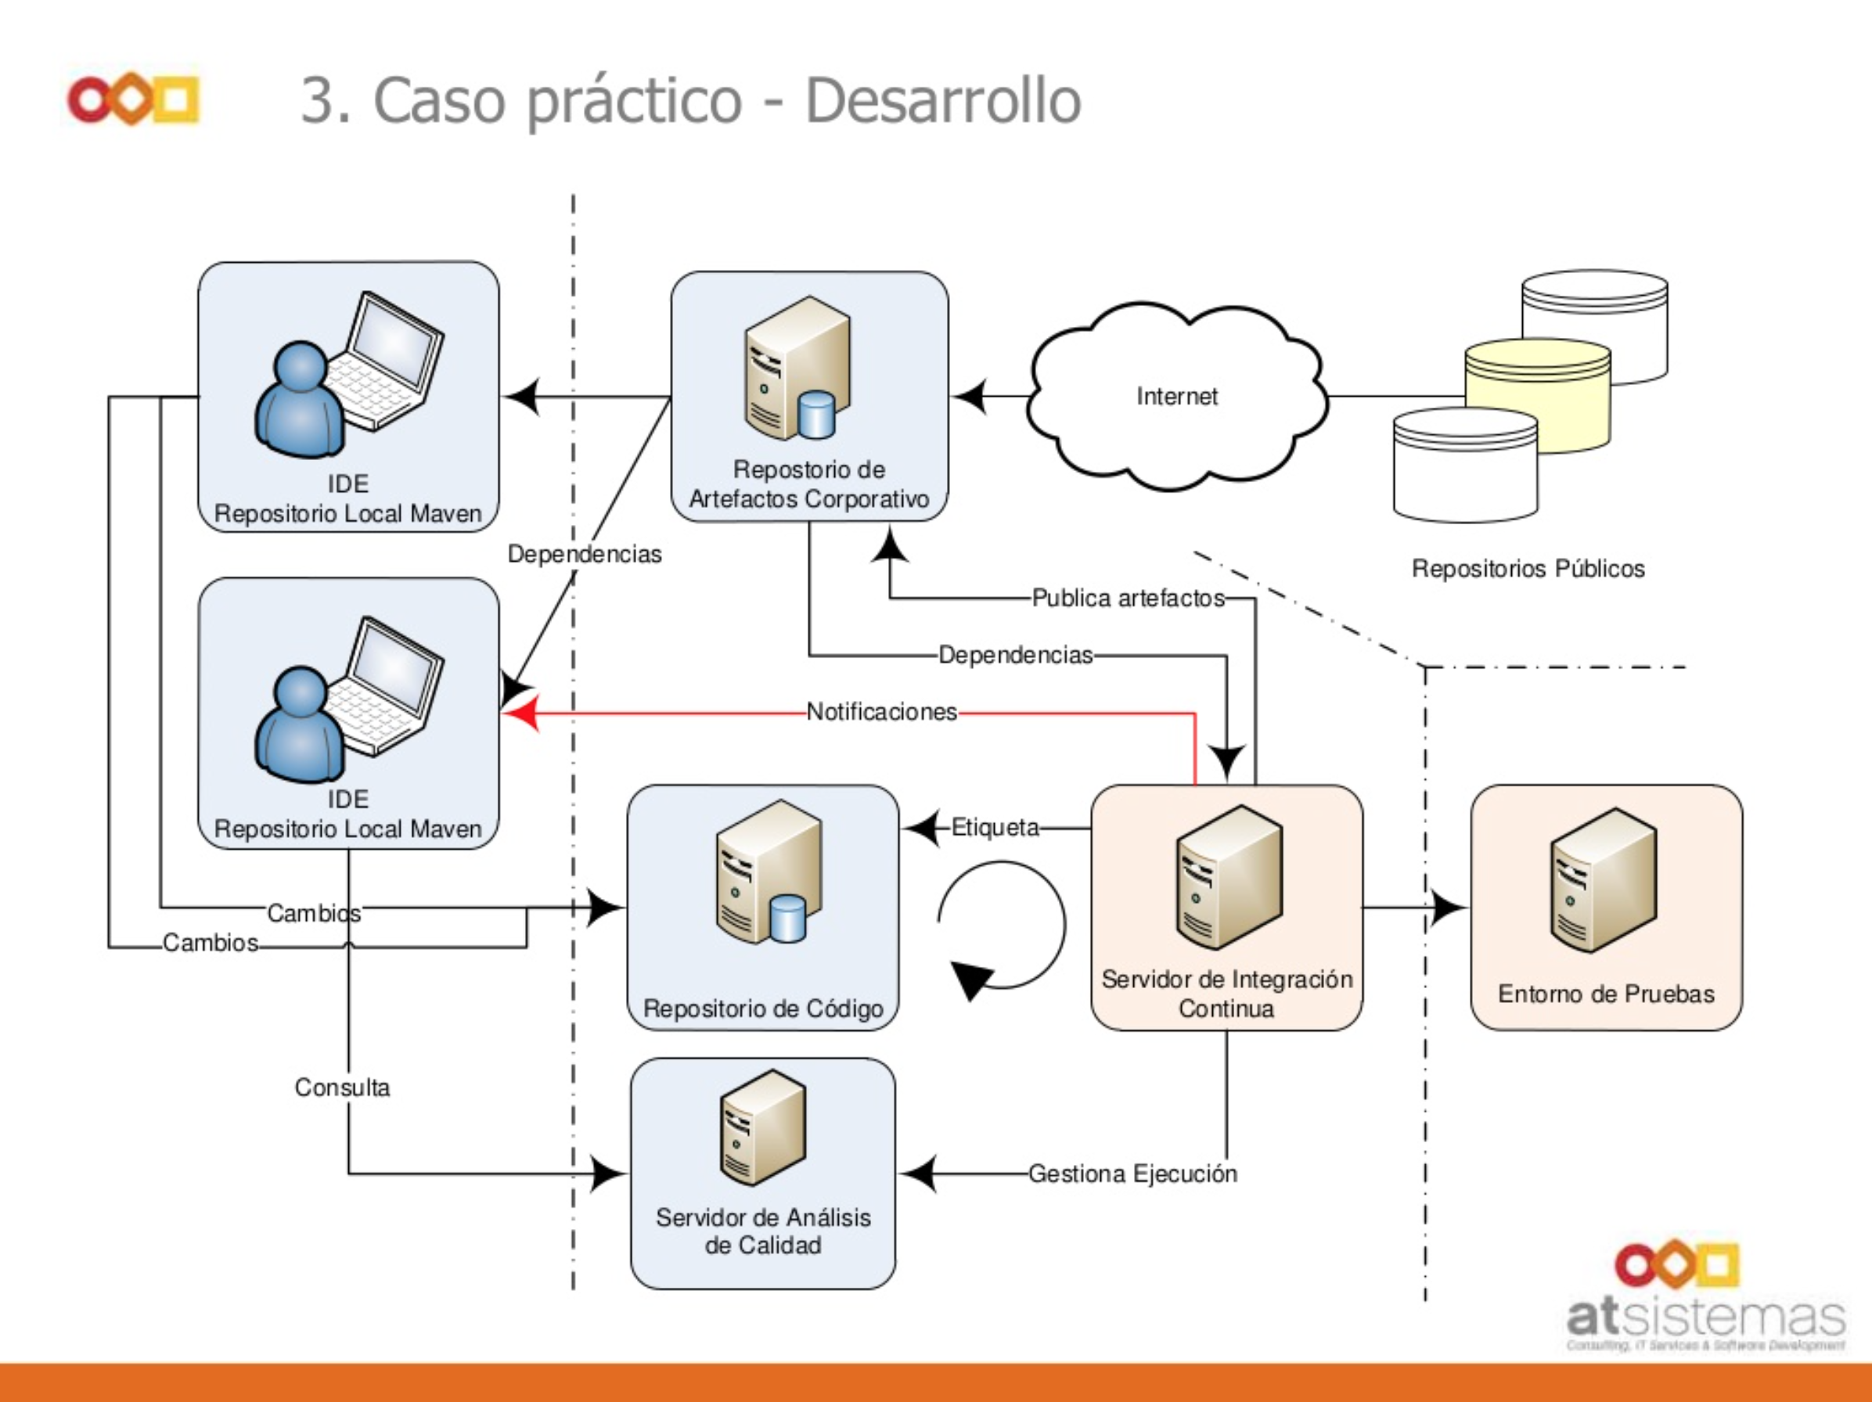
According to atSistemas
Link to Presentation: Presentación Integración
http://bit.ly/20rGSIr
Notes:
Continuous Delivery and DevOps Reference Architectures include many common tool choices. The most common tool choices we find in these reference architectures are: Eclipse, git, Cloudbees Jenkins / Atlassian Bamboo, Sonatype Nexus, Atlassian JIRA, SonarQube, Puppet, Chef, Rundeck, Maven / Ant / Gradle, Subversion (svn), Junit, LiveRebel, ServiceNow

Slide 26

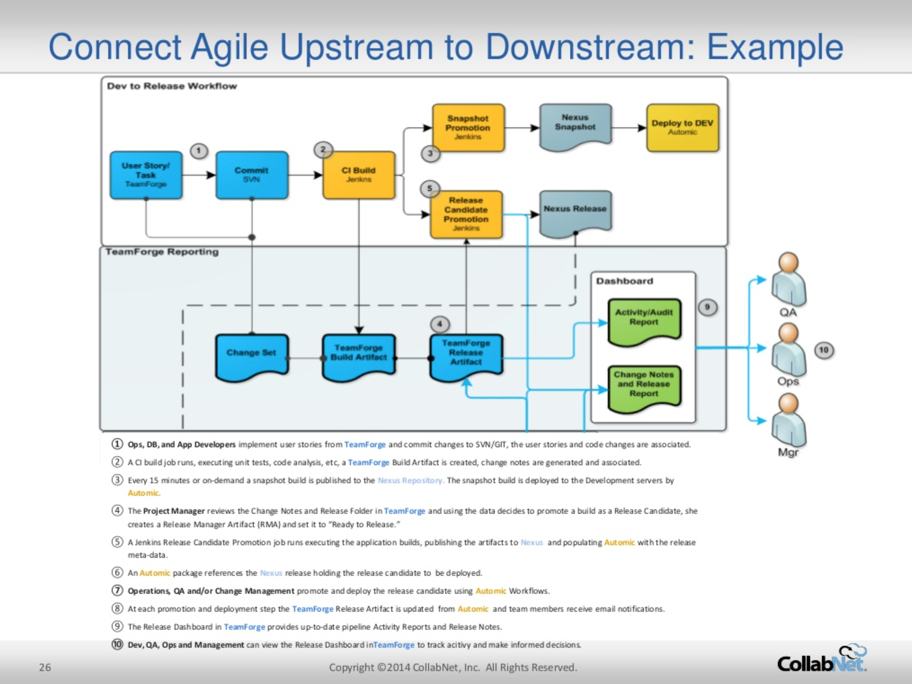
According to CollabNet
Link to Presentation: Linking Upstream & Downstream
http://bit.ly/1WKUxMv
Notes:
Continuous Delivery and DevOps Reference Architectures include many common tool choices. The most common tool choices we find in these reference architectures are: Eclipse, git, Cloudbees Jenkins / Atlassian Bamboo, Sonatype Nexus, Atlassian JIRA, SonarQube, Puppet, Chef, Rundeck, Maven / Ant / Gradle, Subversion (svn), Junit, LiveRebel, ServiceNow

Slide 27

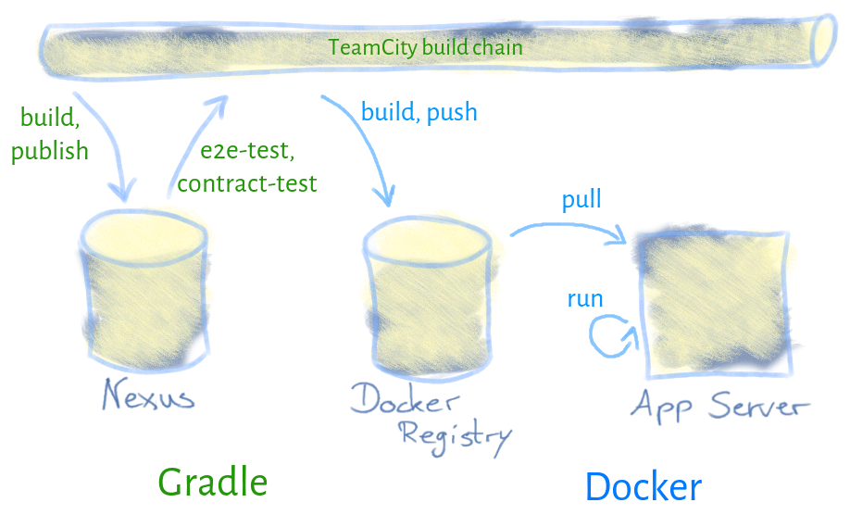
According to Hypoport AG
Link to Blog: Continuous Deployment
http://bit.ly/1U9vcs9 /
Notes:
Continuous Delivery and DevOps Reference Architectures include many common tool choices. The most common tool choices we find in these reference architectures are: Eclipse, git, Cloudbees Jenkins / Atlassian Bamboo, Sonatype Nexus, Atlassian JIRA, SonarQube, Puppet, Chef, Rundeck, Maven / Ant / Gradle, Subversion (svn), Junit, LiveRebel, ServiceNow

Slide 28

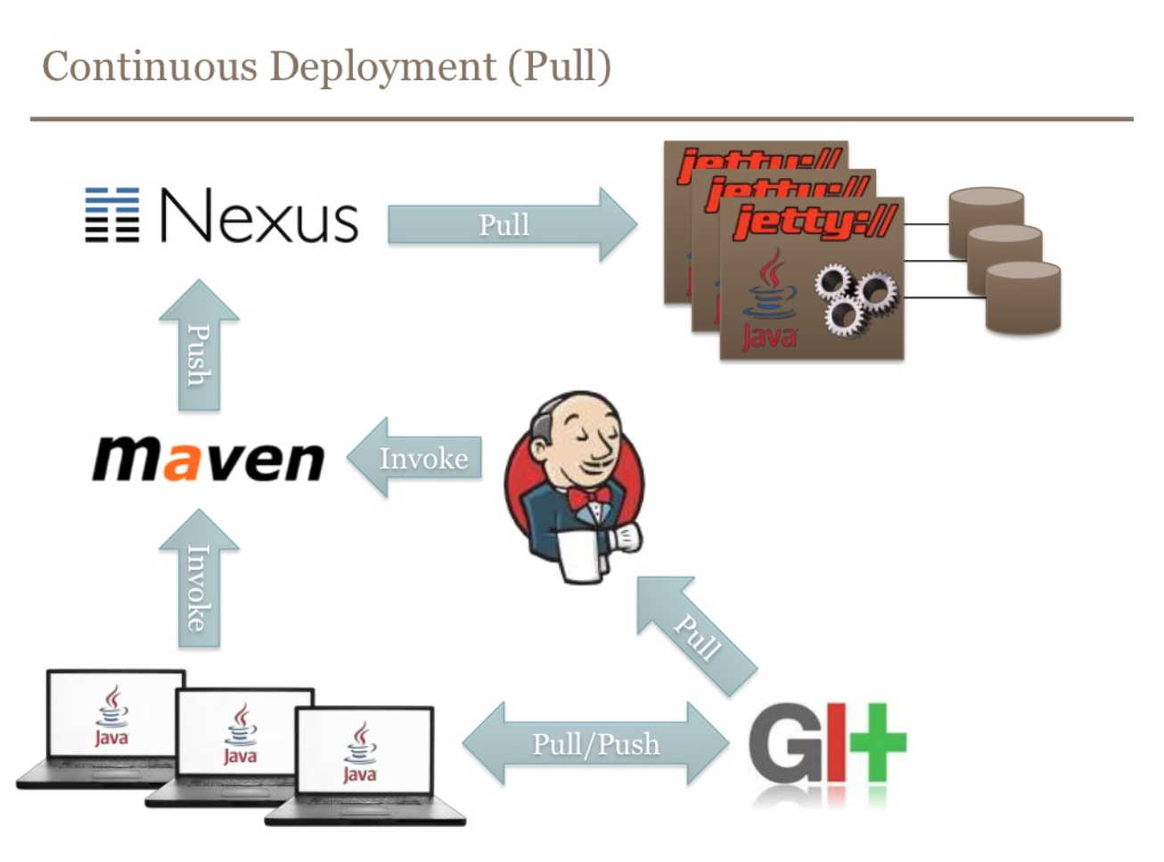
According to BEKK
Link to Presentation: Continuous Delivery
http://bit.ly/244K51A
Notes:
Continuous Delivery and DevOps Reference Architectures include many common tool choices. The most common tool choices we find in these reference architectures are: Eclipse, git, Cloudbees Jenkins / Atlassian Bamboo, Sonatype Nexus, Atlassian JIRA, SonarQube, Puppet, Chef, Rundeck, Maven / Ant / Gradle, Subversion (svn), Junit, LiveRebel, ServiceNow

Slide 29
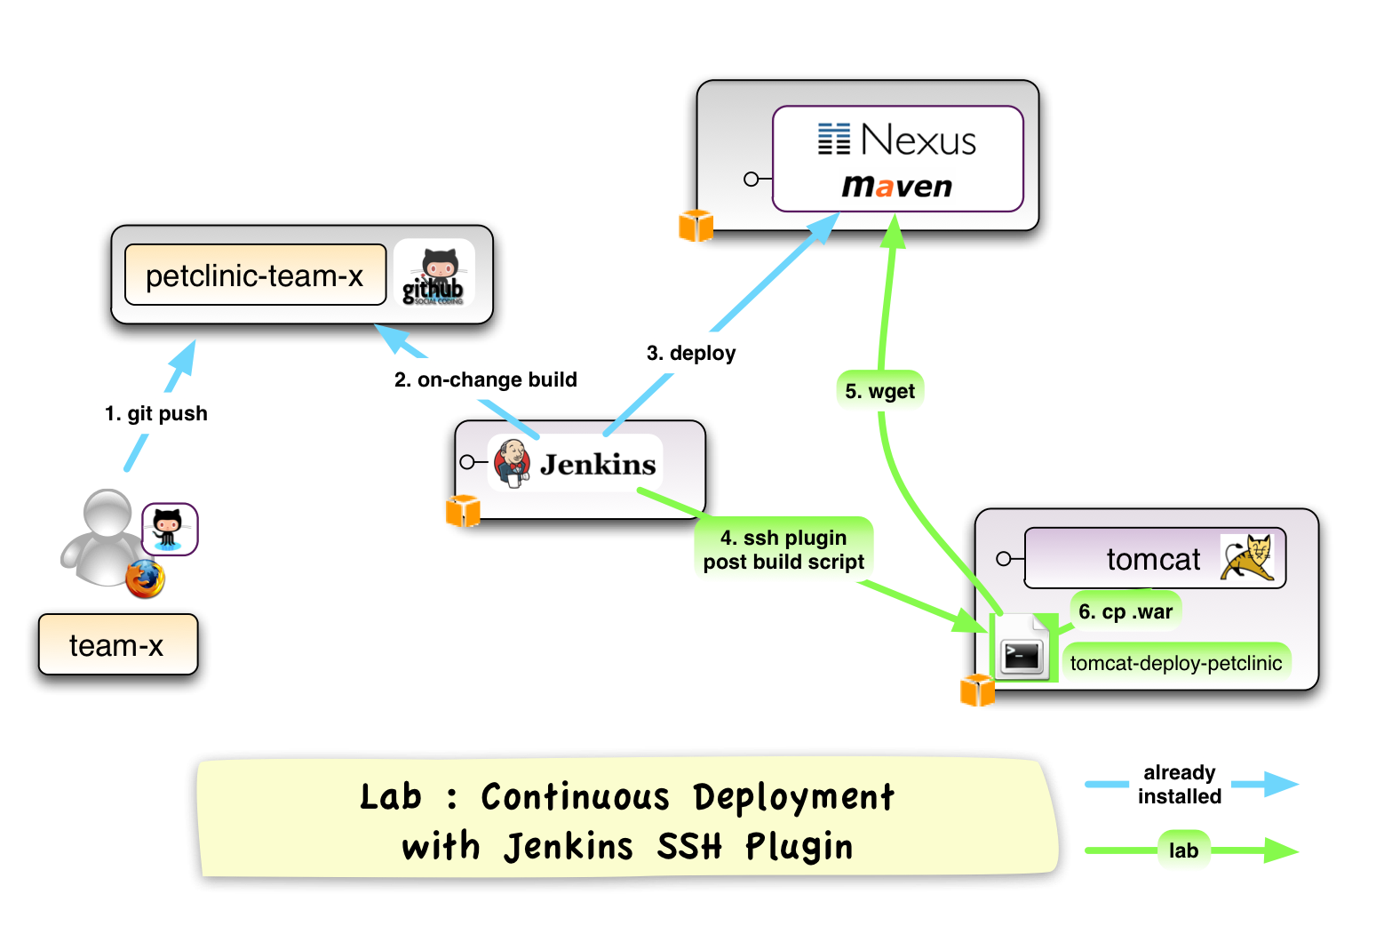
According to Xebia
Link to Presentation: Continuous Delivery Workshop
http://bit.ly/1sxU6IH

Slide 30

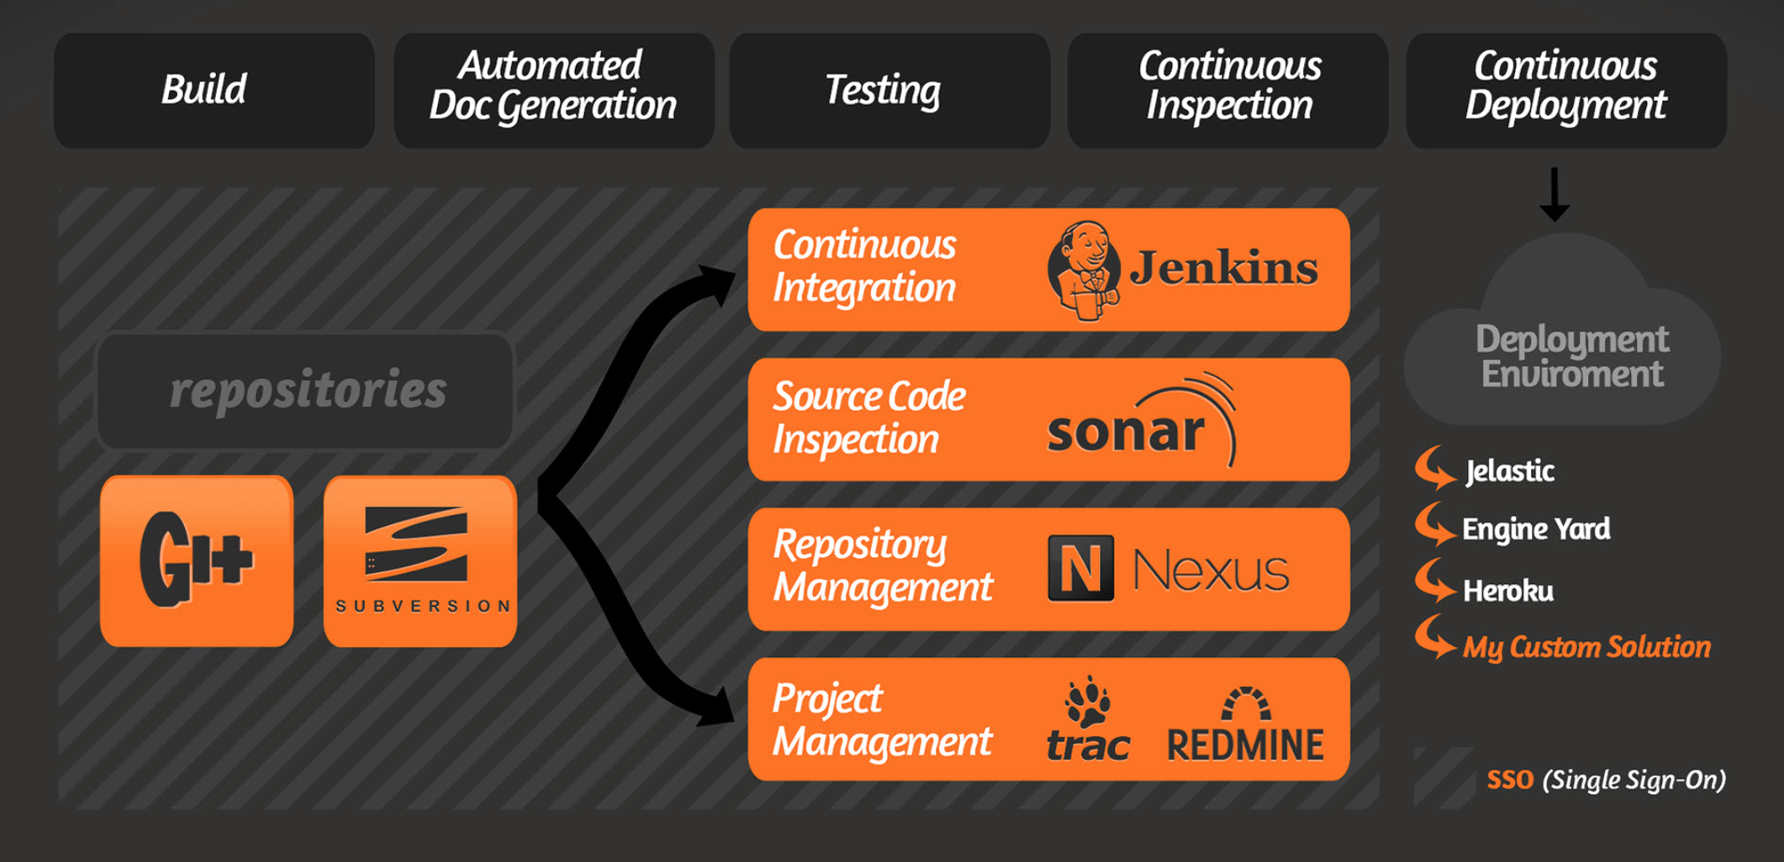
According to ClinkerHQ
Link to Blog: http://blog.clinkerhq.com

Slide 31

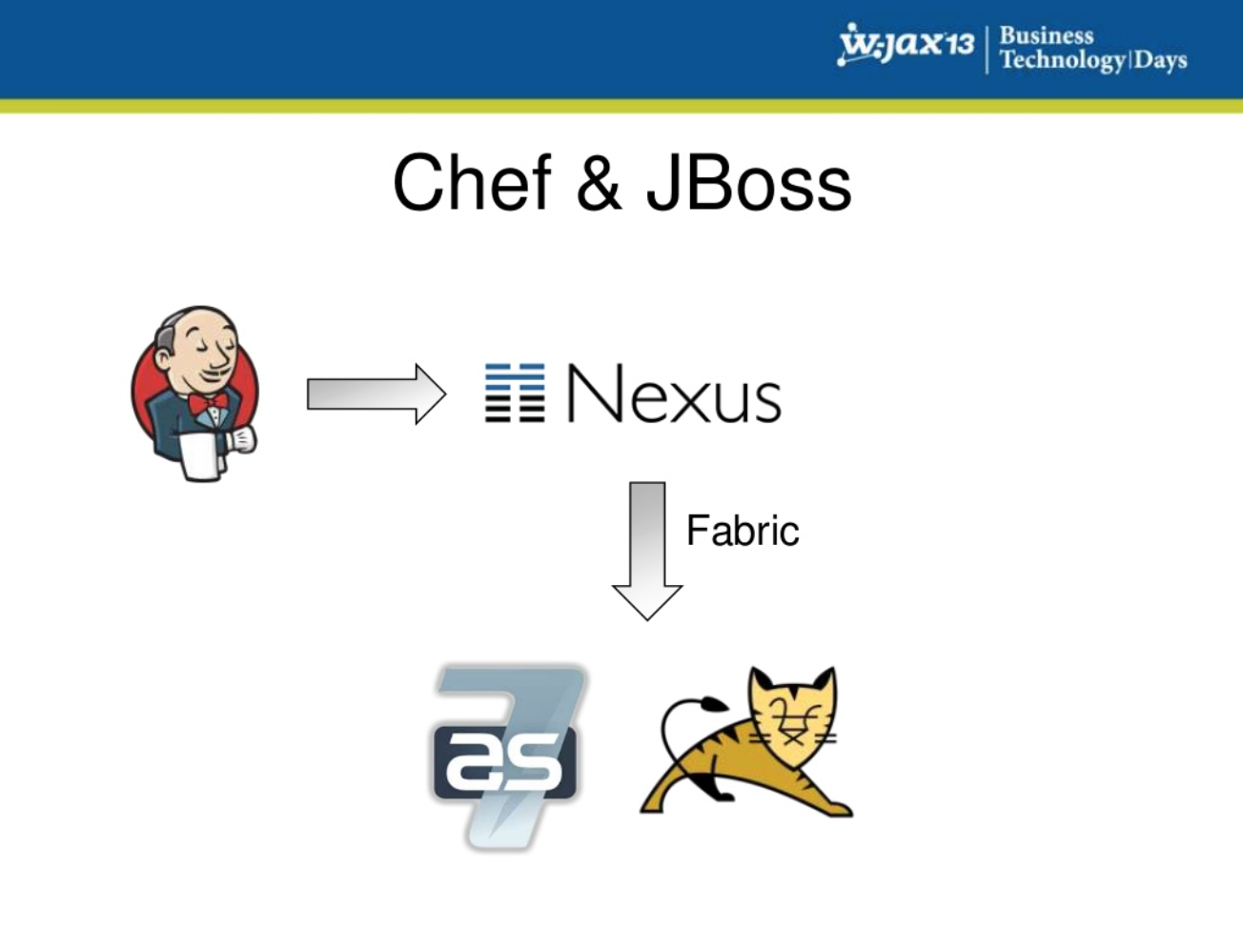
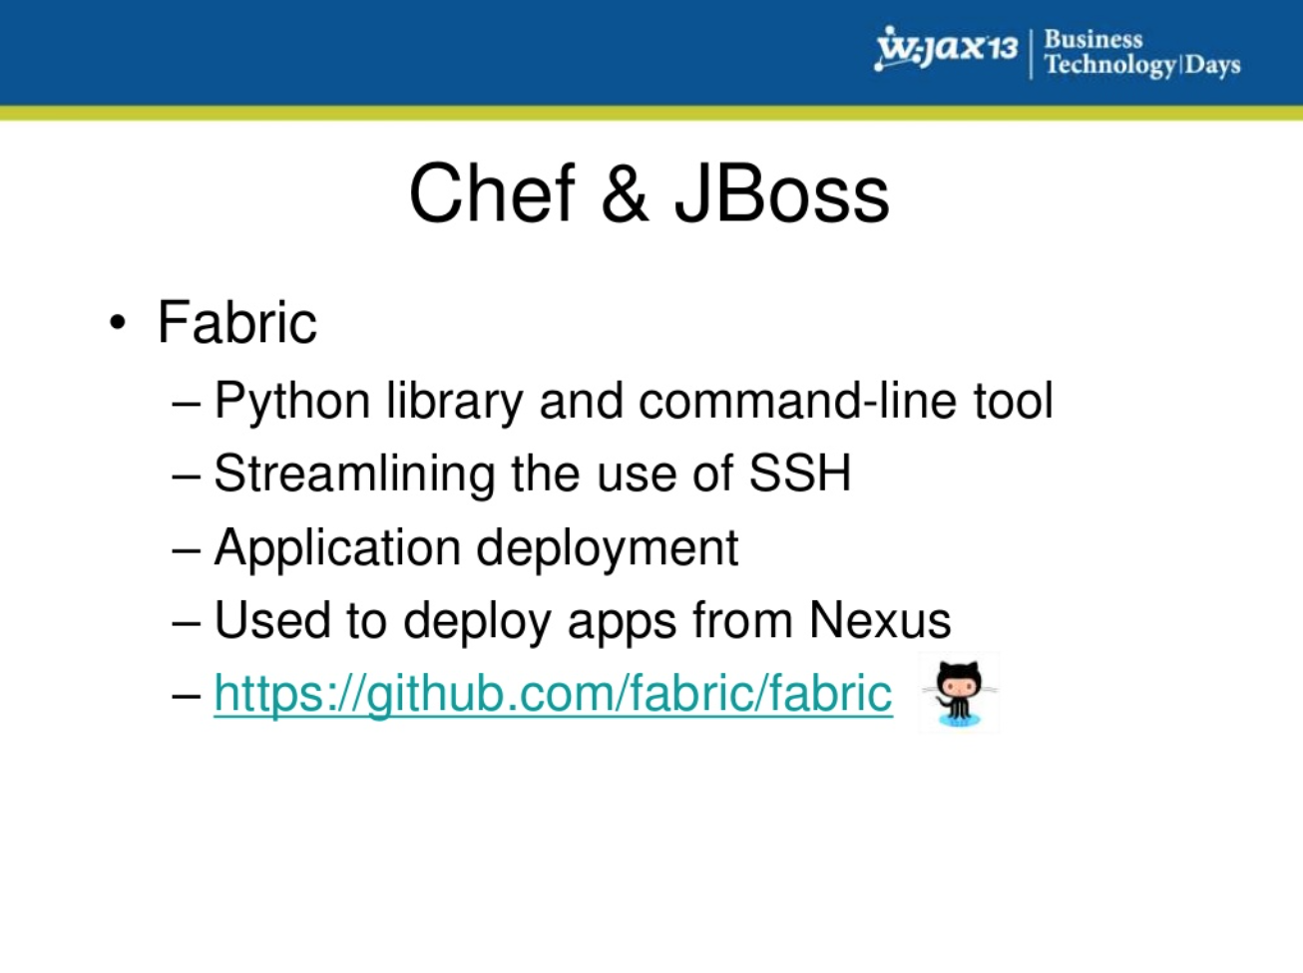
According to Zanox
Link to Presentation: Continuous Delivery
http://bit.ly/1Rl0eZk
Notes:
Continuous Delivery and DevOps Reference Architectures include many common tool choices. The most common tool choices we find in these reference architectures are: Eclipse, git, Cloudbees Jenkins / Atlassian Bamboo, Sonatype Nexus, Atlassian JIRA, SonarQube, Puppet, Chef, Rundeck, Maven / Ant / Gradle, Subversion (svn), Junit, LiveRebel, ServiceNow

Slide 32

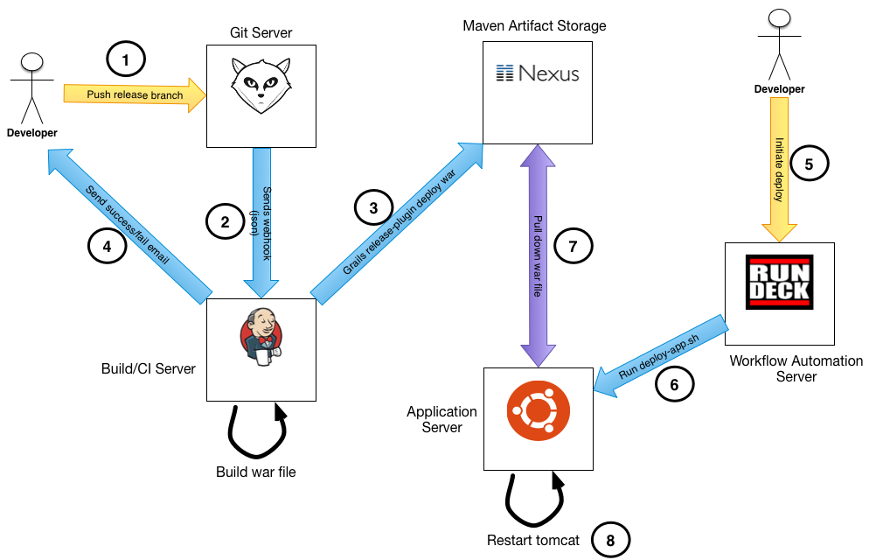
According to Riverside I/O
Link to Blog: Our Developer Toolchain
http://bit.ly/1TrzfTx
Notes:
Continuous Delivery and DevOps Reference Architectures include many common tool choices. The most common tool choices we find in these reference architectures are: Eclipse, git, Cloudbees Jenkins / Atlassian Bamboo, Sonatype Nexus, Atlassian JIRA, SonarQube, Puppet, Chef, Rundeck, Maven / Ant / Gradle, Subversion (svn), Junit, LiveRebel, ServiceNow

Slide 33

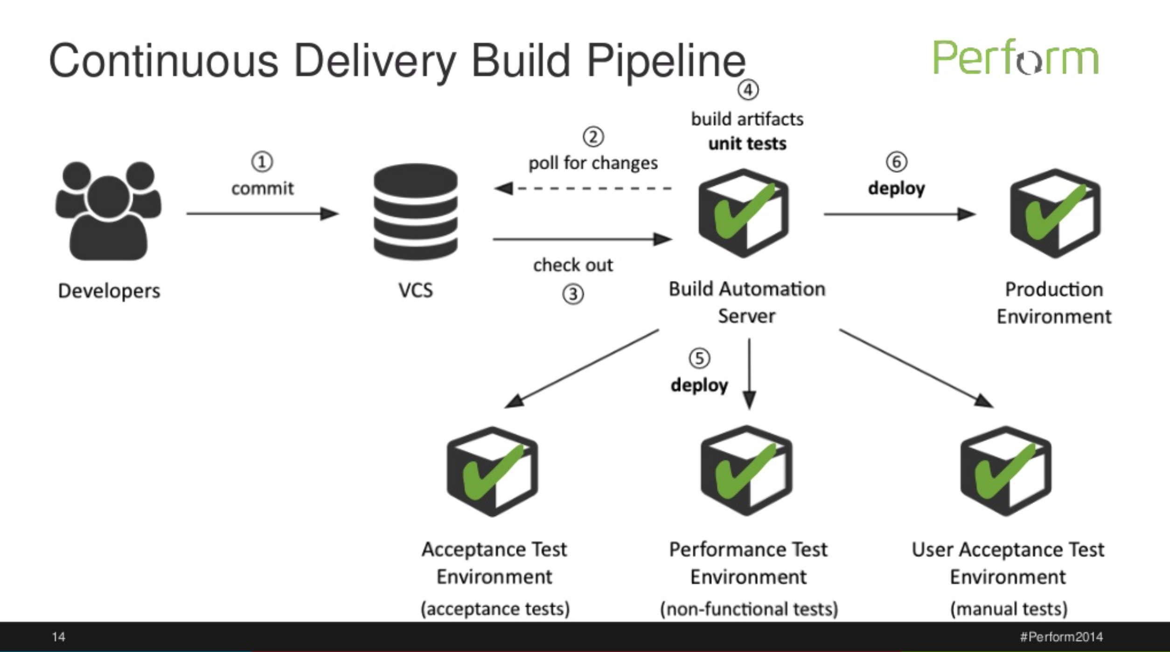
According to Dynatrace
Source: http://bit.ly/1Rl0dVs
Notes:
Continuous Delivery and DevOps Reference Architectures include many common tool choices. The most common tool choices we find in these reference architectures are: Eclipse, git, Cloudbees Jenkins / Atlassian Bamboo, Sonatype Nexus, Atlassian JIRA, SonarQube, Puppet, Chef, Rundeck, Maven / Ant / Gradle, Subversion (svn), Junit, LiveRebel, ServiceNow

Slide 34
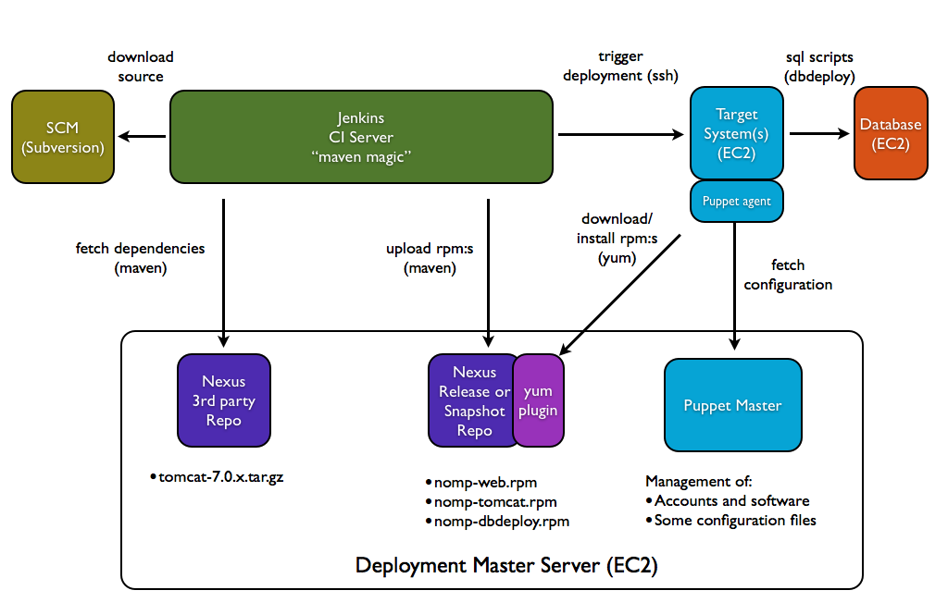
According to Stefan Norberg
Source: http://bit.ly/1Tv2eR6 /

Slide 35

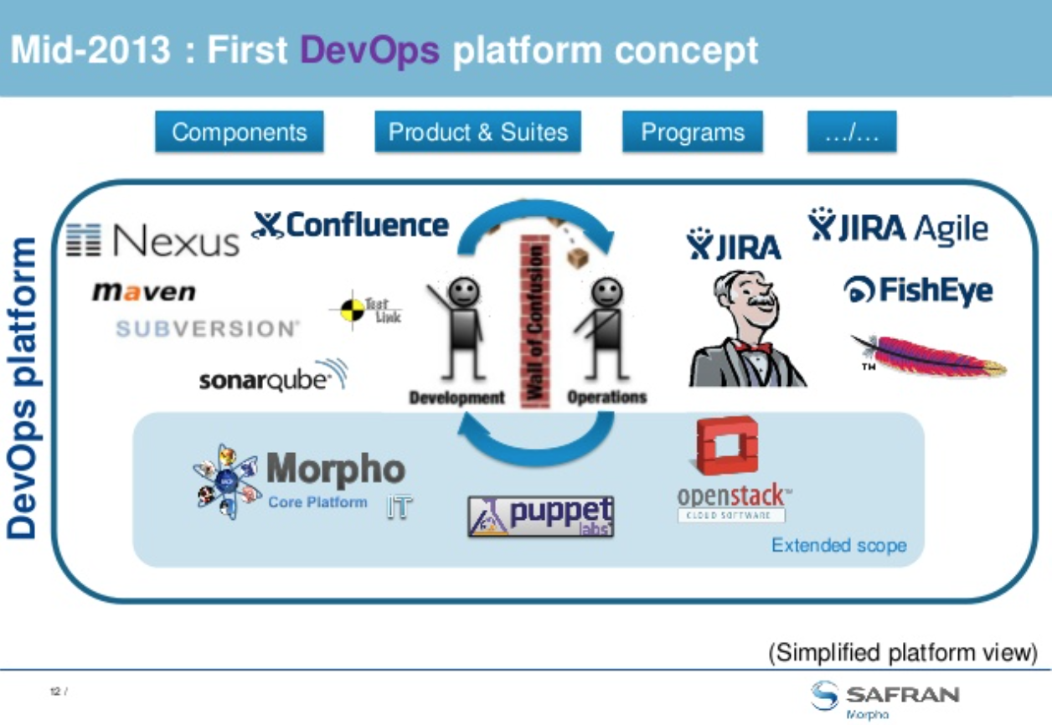
Nexus at Morpho
Source: http://bit.ly/1VfOVJ1

Slide 36
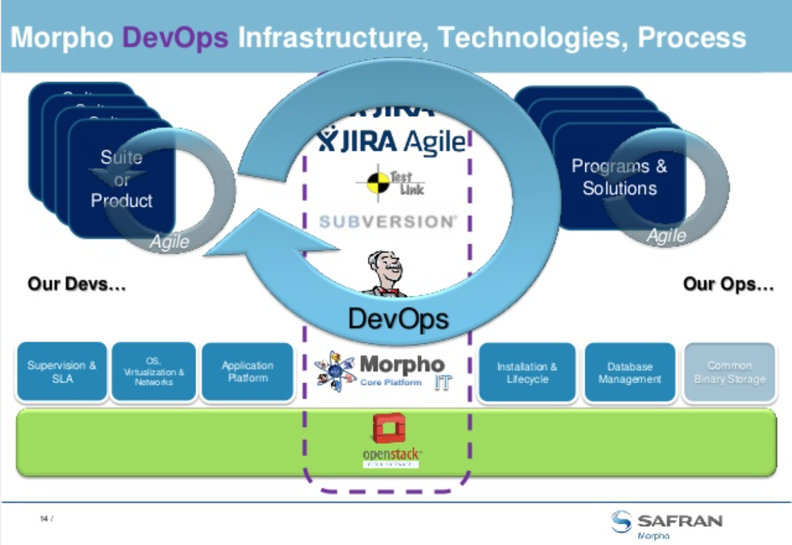
According to Morpho
Source: http://bit.ly/1VfOVJ1

Slide 37
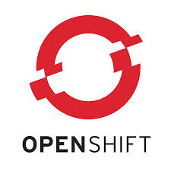
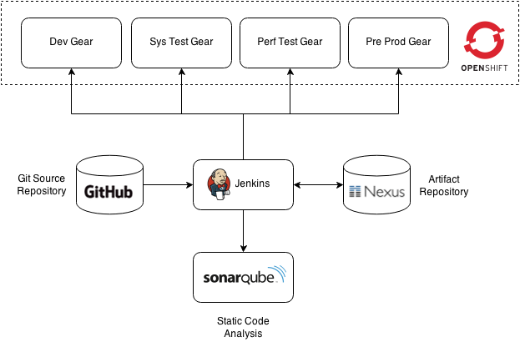
According to OPENSHIFT
Source: http://bit.ly/1NHwD1C
Notes:
Continuous Delivery and DevOps Reference Architectures include many common tool choices. The most common tool choices we find in these reference architectures are: Eclipse, git, Cloudbees Jenkins / Atlassian Bamboo, Sonatype Nexus, Atlassian JIRA, SonarQube, Puppet, Chef, Rundeck, Maven / Ant / Gradle, Subversion (svn), Junit, LiveRebel, ServiceNow

Slide 38

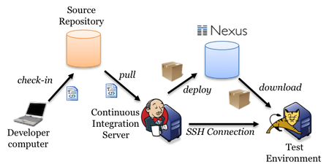
According to akquinet
Link to Blog: Jumping into Continuous Delivery
http://bit.ly/25i7tyx
Notes:
Continuous Delivery and DevOps Reference Architectures include many common tool choices. The most common tool choices we find in these reference architectures are: Eclipse, git, Cloudbees Jenkins / Atlassian Bamboo, Sonatype Nexus, Atlassian JIRA, SonarQube, Puppet, Chef, Rundeck, Maven / Ant / Gradle, Subversion (svn), Junit, LiveRebel, ServiceNow

Slide 39

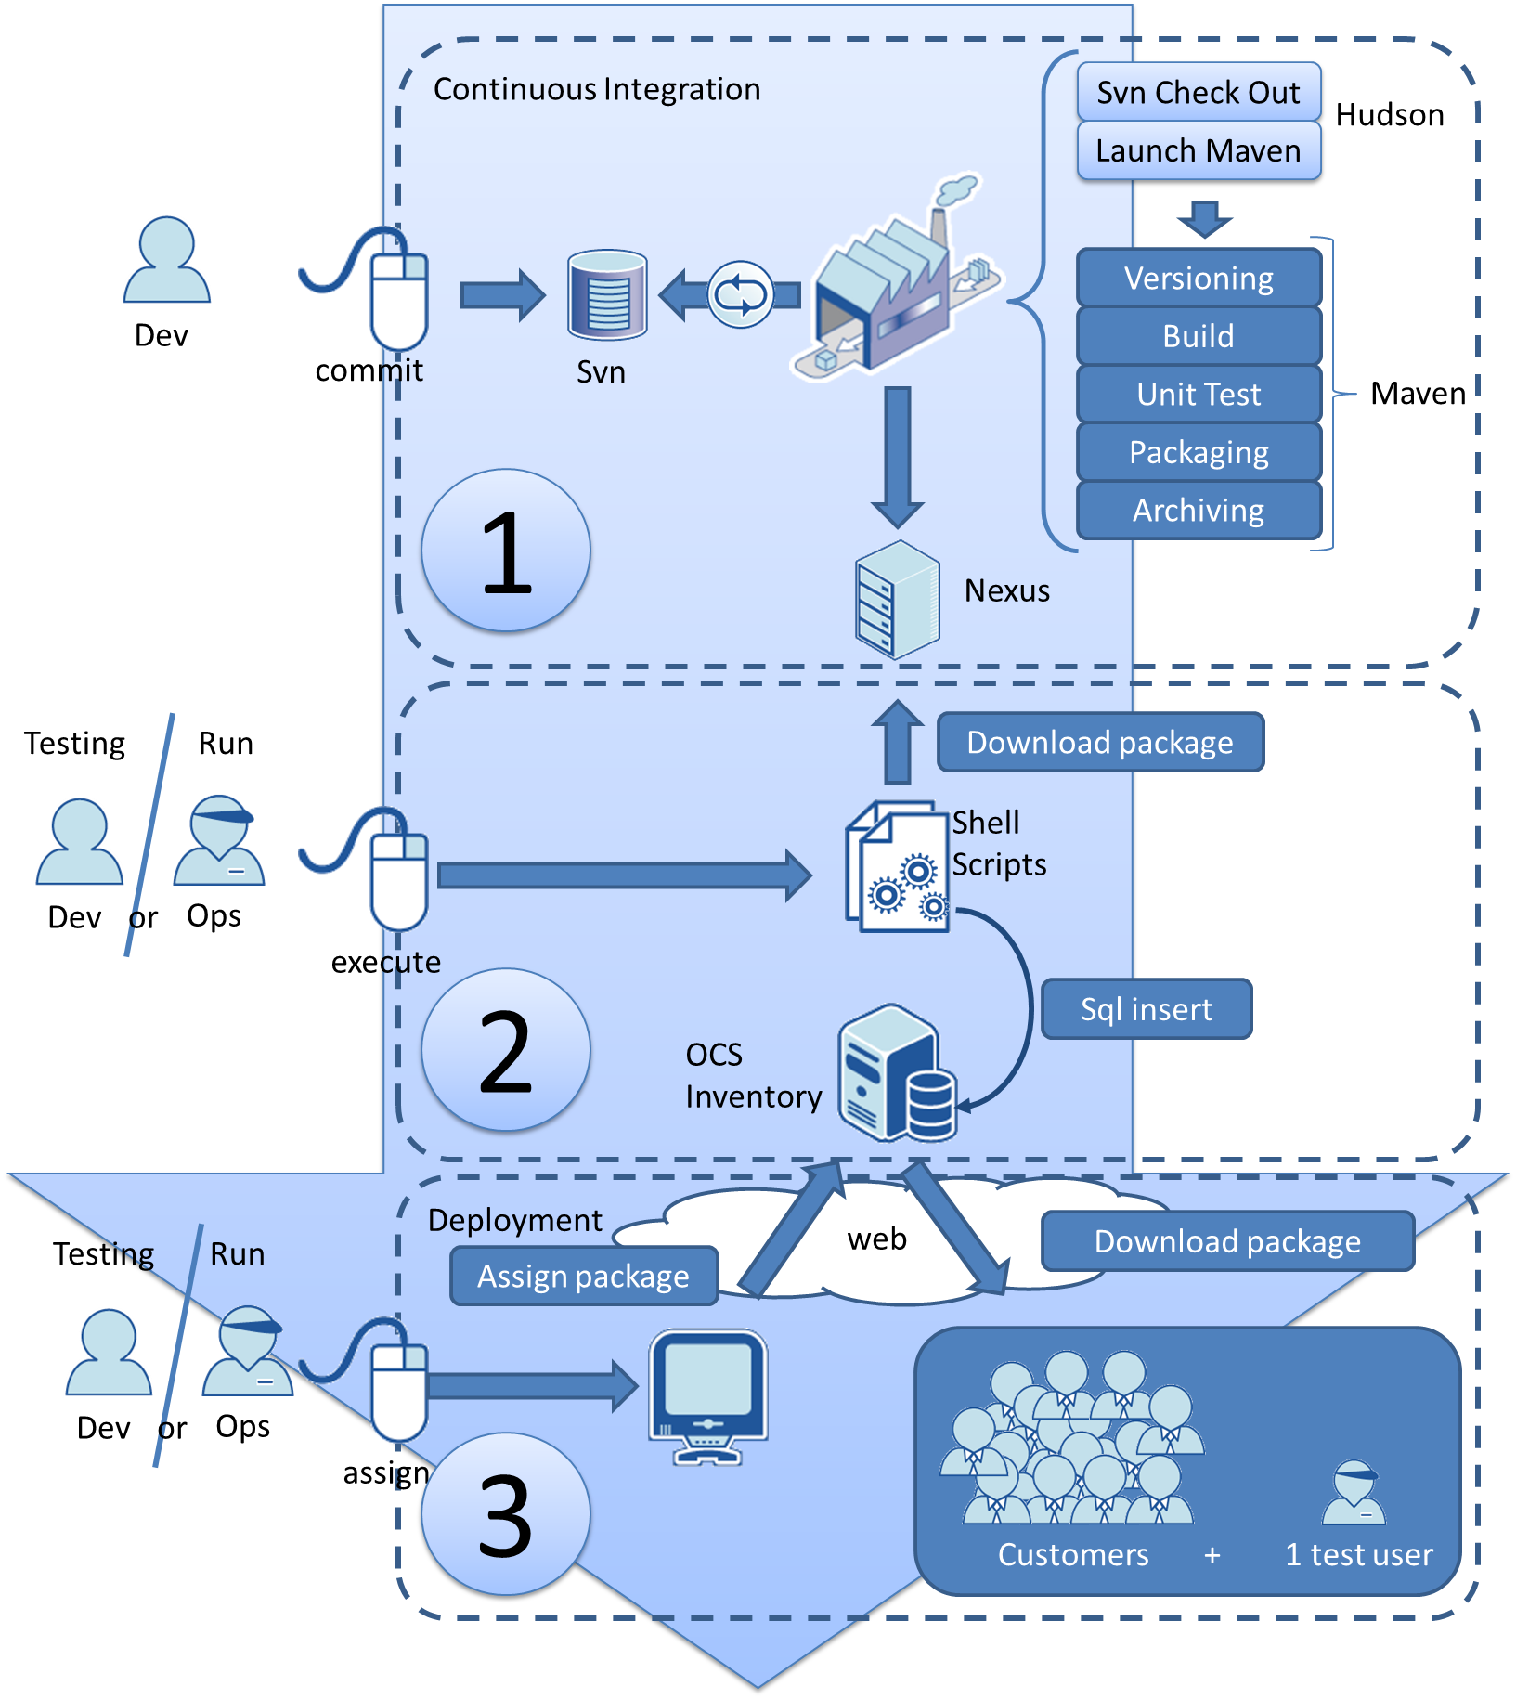
According to OCTO
Link to Blog: Continuous Delivery
http://bit.ly/1U7bIBn
Notes:
Continuous Delivery and DevOps Reference Architectures include many common tool choices. The most common tool choices we find in these reference architectures are: Eclipse, git, Cloudbees Jenkins / Atlassian Bamboo, Sonatype Nexus, Atlassian JIRA, SonarQube, Puppet, Chef, Rundeck, Maven / Ant / Gradle, Subversion (svn), Junit, LiveRebel, ServiceNow

Slide 40
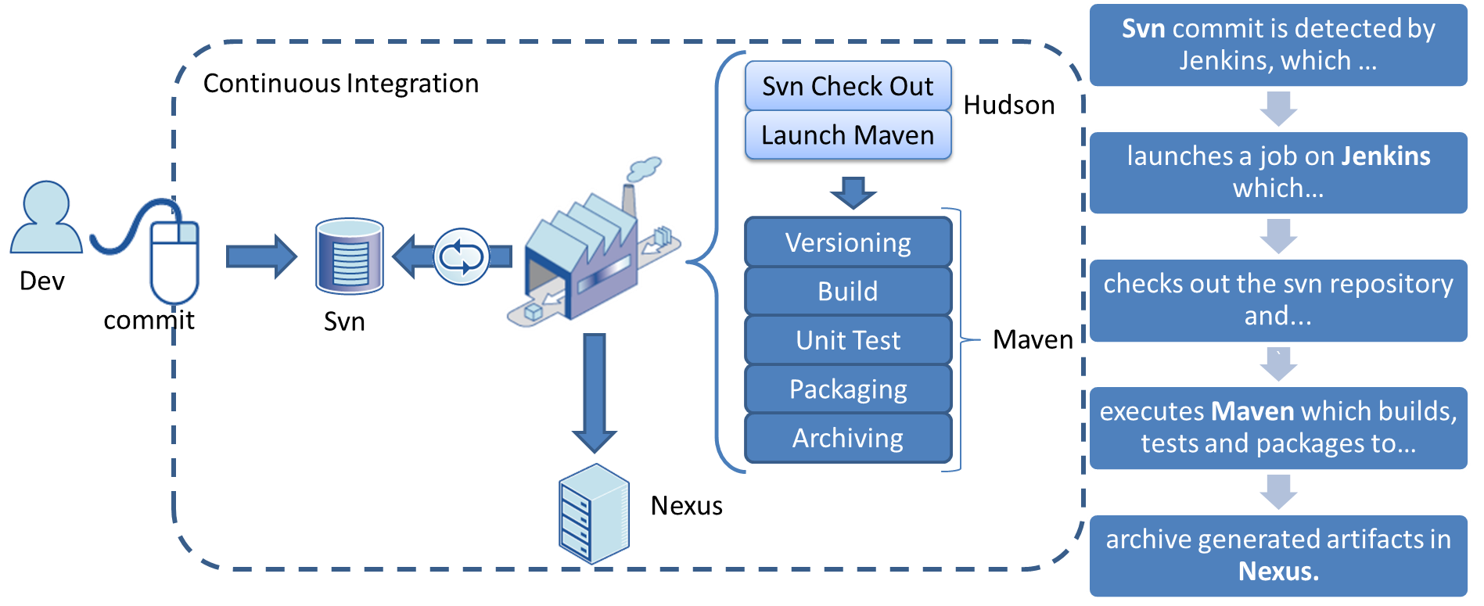
According to OCTO
Link to Blog: Continuous Delivery
http://bit.ly/1U7bIBn
Notes:
Continuous Delivery and DevOps Reference Architectures include many common tool choices. The most common tool choices we find in these reference architectures are: Eclipse, git, Cloudbees Jenkins / Atlassian Bamboo, Sonatype Nexus, Atlassian JIRA, SonarQube, Puppet, Chef, Rundeck, Maven / Ant / Gradle, Subversion (svn), Junit, LiveRebel, ServiceNow

Slide 41
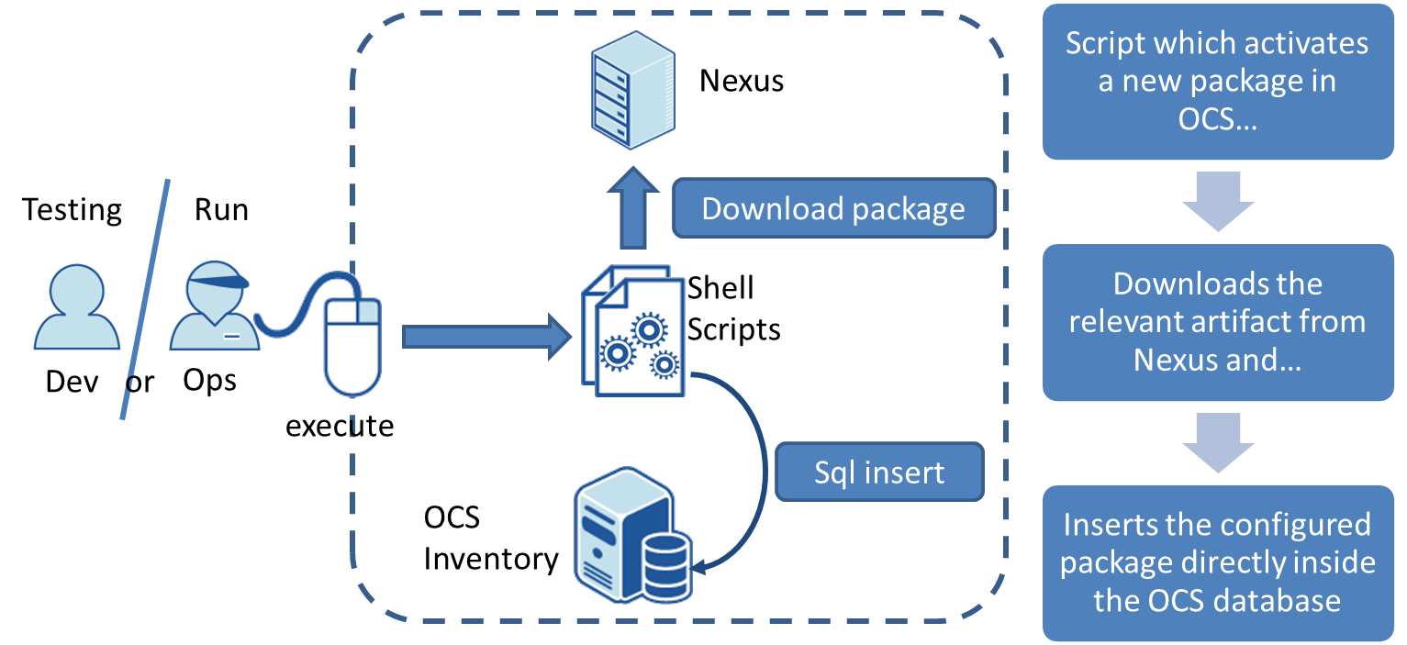
According to OCTO
Link to Blog: Continuous Delivery
http://bit.ly/1U7bIBn
Notes:
Continuous Delivery and DevOps Reference Architectures include many common tool choices. The most common tool choices we find in these reference architectures are: Eclipse, git, Cloudbees Jenkins / Atlassian Bamboo, Sonatype Nexus, Atlassian JIRA, SonarQube, Puppet, Chef, Rundeck, Maven / Ant / Gradle, Subversion (svn), Junit, LiveRebel, ServiceNow

Slide 42
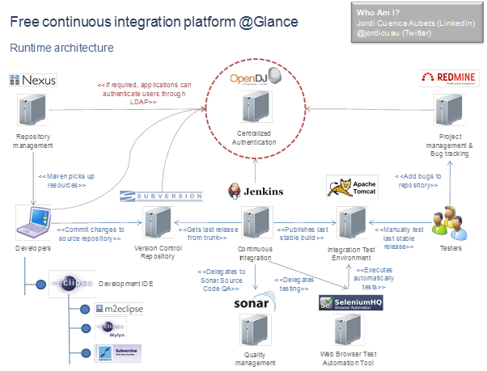
According to Jordi Cuenca-Aubets
Link to Blog: Free Continuous Integration
http://bit.ly/1U9weEs
Notes:
Continuous Delivery and DevOps Reference Architectures include many common tool choices. The most common tool choices we find in these reference architectures are: Eclipse, git, Cloudbees Jenkins / Atlassian Bamboo, Sonatype Nexus, Atlassian JIRA, SonarQube, Puppet, Chef, Rundeck, Maven / Ant / Gradle, Subversion (svn), Junit, LiveRebel, ServiceNow

Slide 43


According to Open Sourcerers
Link to Blog: Continuous Delivery using PaaS
http://bit.ly/1WNMIq0
Notes:
Continuous Delivery and DevOps Reference Architectures include many common tool choices. The most common tool choices we find in these reference architectures are: Eclipse, git, Cloudbees Jenkins / Atlassian Bamboo, Sonatype Nexus, Atlassian JIRA, SonarQube, Puppet, Chef, Rundeck, Maven / Ant / Gradle, Subversion (svn), Junit, LiveRebel, ServiceNow

Slide 44

According to Michael Rumpf
Link to Blog: Integrating Jenkins, SonarQube, and Nexus
http://bit.ly/20rLf6u
Notes:
Continuous Delivery and DevOps Reference Architectures include many common tool choices. The most common tool choices we find in these reference architectures are: Eclipse, git, Cloudbees Jenkins / Atlassian Bamboo, Sonatype Nexus, Atlassian JIRA, SonarQube, Puppet, Chef, Rundeck, Maven / Ant / Gradle, Subversion (svn), Junit, LiveRebel, ServiceNow

Slide 45

According to Cardlife
Link to Blog: How I use Rundeck
http://bit.ly/25i8AhP

Slide 46

According to Paolo Antinori, RedHat
Link to Blog: Continuous Integration
http://bit.ly/1sxX6ok
Notes:
Continuous Delivery and DevOps Reference Architectures include many common tool choices. The most common tool choices we find in these reference architectures are: Eclipse, git, Cloudbees Jenkins / Atlassian Bamboo, Sonatype Nexus, Atlassian JIRA, SonarQube, Puppet, Chef, Rundeck, Maven / Ant / Gradle, Subversion (svn), Junit, LiveRebel, ServiceNow

Slide 47


According to Atlassian
Link to Presentation: Puppet Camp Sydney
http://bit.ly/1VfPgLL

Slide 48


According to Continuous Delivery Ltd
Link to Presentation: The Rationale for Continuous Delivery
http://bit.ly/1WdmsVa

Slide 49


According to CollabNet
Source: http://bit.ly/1s5i8ea
Notes:
Continuous Delivery and DevOps Reference Architectures include many common tool choices. The most common tool choices we find in these reference architectures are: Eclipse, git, Cloudbees Jenkins / Atlassian Bamboo, Sonatype Nexus, Atlassian JIRA, SonarQube, Puppet, Chef, Rundeck, Maven / Ant / Gradle, Subversion (svn), Junit, LiveRebel, ServiceNow

Slide 50

According to Nhan Ngo
Source: http://continuousdelivery.com

Slide 51

According to Nhan Ngo
Source: http://continuousdelivery.com

Slide 52

According to Nhan Ngo
Source: http://continuousdelivery.com

Slide 53

According to Nhan Ngo
Source: http://continuousdelivery.com

Slide 54


According to WS02
Source: http://bit.ly/1WdmNaC

Slide 55


According to CodeCentric
Source: http://bit.ly/20rNMO0
Notes:
Continuous Delivery and DevOps Reference Architectures include many common tool choices. The most common tool choices we find in these reference architectures are: Eclipse, git, Cloudbees Jenkins / Atlassian Bamboo, Sonatype Nexus, Atlassian JIRA, SonarQube, Puppet, Chef, Rundeck, Maven / Ant / Gradle, Subversion (svn), Junit, LiveRebel, ServiceNow

Slide 56

According to WS02
Source: http://bit.ly/1TzgWZM

Slide 57

According to Momentum SI
Source: http://bit.ly/1U9xSG9

Slide 58

According to Goobbe
Source: http://bit.ly/1TGH46f

Slide 59


According to IBM
Source: http://ibm.co/27QRarp

Slide 60

According to IBM
Source: http://ibm.co/22mhKV2

Slide 61

According to IBM
Source: http://bit.ly/1Tzhsa6

Slide 62

According to IBM
Source: http://bit.ly/1YSETfS

Slide 63


According to OZsofts
Source: http://bit.ly/22mhLZc

Slide 64


According to MaestroDev
Source: http://bit.ly/1U7cr5D

Slide 65


According to The Open Group
Source: http://bit.ly/1XsbMRP

Slide 66


According to AgileTrick
Source: http://bit.ly/27QR6rC

Slide 67


According to DevOps by Design
Source: http://bit.ly/1U9yXOd

Slide 68

According to HP
Source: http://bit.ly/1TrFgQg

Slide 69

According to Eljto
Source: http://bit.ly/20rQp2p

Slide 70

According to DATAPIPE
Source: http://bit.ly/1sNcH4f

Slide 71

According to Spirent
Source: http://bit.ly/1TGJkdH

Slide 72

According to Always Agile
Source: http://bit.ly/27QRtCn

Slide 73

According to Assembla
Source: http://bit.ly/1TrGawb

Slide 74

According to Girikon
Source: http://bit.ly/20rS1ZV

Slide 75

According to Bartholomeus
Source: http://bit.ly/244Nxcs

Slide 76
57 sessions. 15 Time Zones. 15 Hours. Nov 15. Register for Free @ www.AllDayDevOps.com
Notes:
Last year, we jump-started thousands of DevOps journeys. And we validated many more. We did this by publishing 31 DevOps and Continuous Delivery reference architectures. These reference sheets have now been viewed more than 70,000 times. Some are simple, some complex. But all from the real world.

